Slide 1
Waves
Physical Science

Slide 2
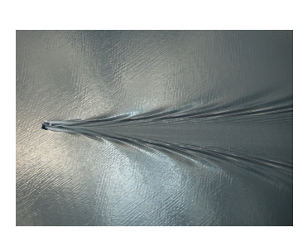
Waves
All waves carry energy without transporting matter.
A wave will continue to travel as long as it has energy to carry

Slide 3
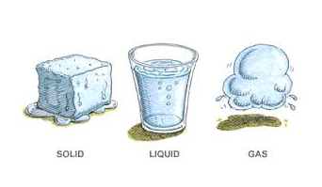
Mechanical Waves
Mechanical waves are waves that travel through a medium.
A medium can be a solid, a liquid, a gas, or a combination of these.
Mechanical waves can either be compressional waves (also called longitudinal) or transverse waves.

Slide 4
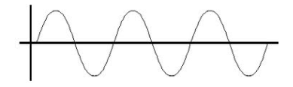
In a transverse wave, matter in the medium moves back and forth at right angles to the direction the wave is traveling .

Slide 5
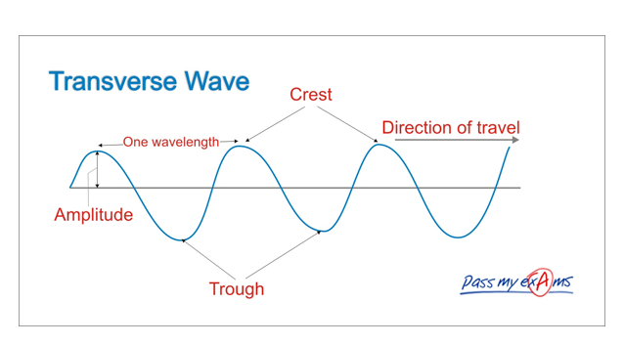

Slide 6
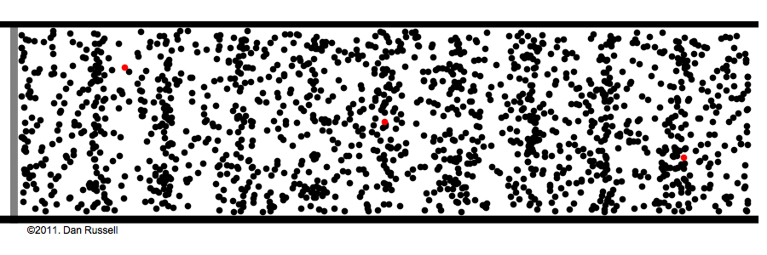
Compressional Waves
In a compressional wave, the medium moves back and forth along the same direction the wave travels.
Ex. Sound waves

Slide 7
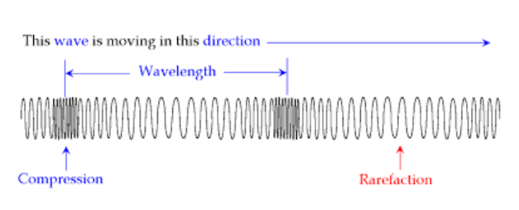

Slide 8
The frequency of a wave are the number of wavelengths that pass a fixed point each second.
The period is the amount of time that it takes for one wavelength to pass a point.
As the frequency of a wave decreases, the period increases.

Slide 9
The speed of a wave depends on the medium it is traveling through.
Sound waves travel faster in liquids and solids than they do in gases.
Light waves travel slower in liquids and solids than they do in gases or empty space.

Slide 10
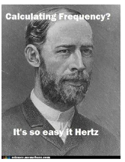
To calculate wave speed, you multiple the frequency (in hertz) by the wavelength (in meters).

Slide 11
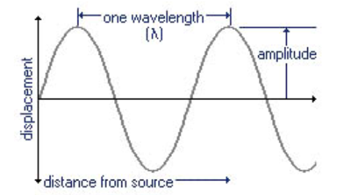
Energy of a Wave
Amplitude is related to the energy carried by a wave. The greater the waves amplitude the greater the waves energy.

