Slide 1
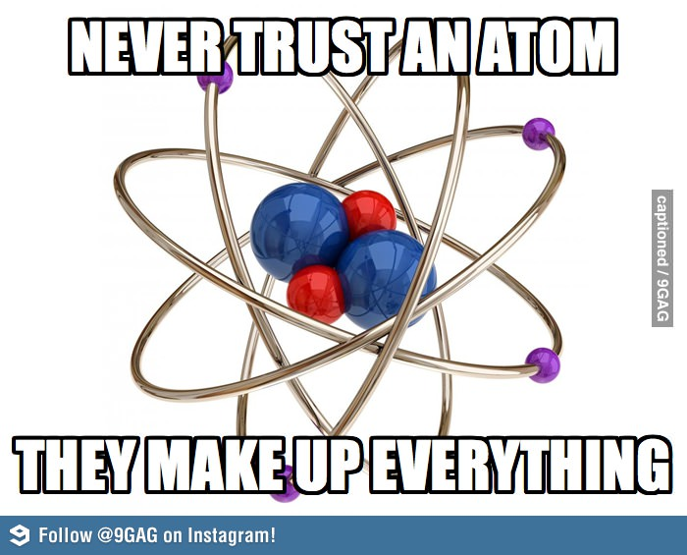
The Structure of Atoms Notes
Physical Science
Chpt 17.2

Slide 2
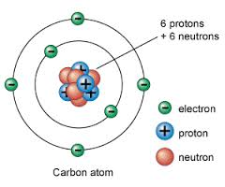
What’s in an Atom?
In the nucleus there are:
Protons: = 1+ charge
Neutrons = no charge
Surrounding the nucleus there are
Electrons: 1- charge

Slide 3
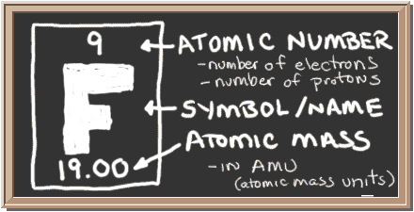
How to Read the Periodic Table

Slide 4
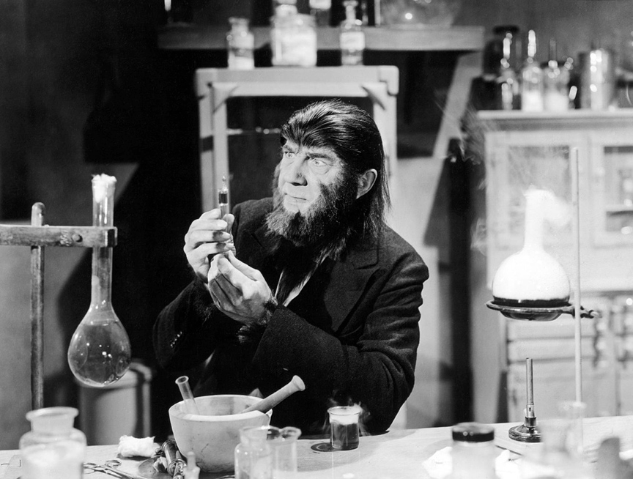
How do you calculate the number of protons, neutrons, and electrons in an atom?
You can use the A=P=E M-A=N Method to determine the number of neutrons, protons and electrons if you know the atomic number and atomic mass or vice versa.

Slide 5
A = P = E
Atomic number = # of protons = # of electrons
The number of protons in an atom is equal to the atomic number
The number of protons will equal the number of electrons to the charge is neutral

Slide 6
M - A = N
Mass number - Atomic number = # of neutrons
The mass number of an atom is the sum of the number of protons and the number of neutrons in the nucleus of an atom

Slide 7
Let’s try a few
Potassium has an atomic mass of 39 and has 19 electrons. How many neutrons and protons does it have and what is it’s atomic number?

Slide 8
Let’s try a few
Potassium has an atomic mass of 39 and has 19 electrons. How many neutrons and protons does it have and what is it’s atomic number?
A = P = E
A = P = 19
19 = 19 = 19
Atomic number = 19 and it has 19 protons
M = A + N
39 = 19 + N
39 -19 = N
N = 20
20 Neutrons

Slide 9
Let’s try a few
Mercury has an atomic mass of 200 and has 120 neutrons, how many electrons and protons does it have? What is it’s atomic number?

Slide 10
Let’s try a few
Mercury has an atomic mass of 200 and has 120 neutrons, how many electrons and protons does it have? What is it’s atomic number?
M = A + N
200 = A + 120
200 – 120 = A
A = 80
It’s atomic number is 80
A = P = E
80 = P = E
80 = 80 = 80
It has 80 electrons and 80 protons

Slide 11
Electron Cloud Structure

Slide 12
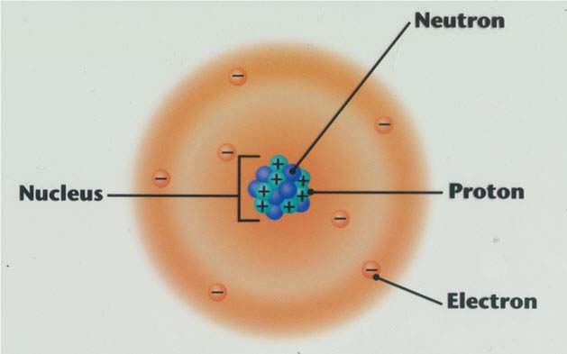
Electron Cloud Structure
Electron cloud = The area around the nucleus in which electrons are located

Slide 13
Electron Cloud Diagrams
Electrons are placed in different levels and different levels can hold a different number of electrons:
1st level = 2 electrons
2nd level = 8 electrons
3rd level = 18 electrons
Electrons fill the 1st level, then the second, then the third, etc.

Slide 14
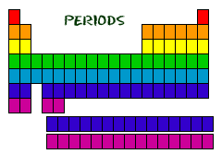
Find out which period (row) your element is in.
Elements in the 1st period have one energy level.
Elements in the 2nd period have two energy levels, and so on.

Slide 15
Draw a nucleus with the element symbol inside.
Carbon is in the 2nd period, so it has two energy levels, or shells.
Draw the shells around the nucleus.
C

Slide 16
Add the electrons.
Carbon has 6 electrons.
The first shell can only hold 2 electrons.
C

Slide 17
Since you have 2 electrons already drawn, you need to add 4 more.
These go in the 2nd shell.
Add one at a time -starting on the right side and going counter clock-wise.
C

Slide 18
Try the following elements on your own:
H
He
O
Al
C

Slide 19
H
He
O
Al

