Slide 1
Solutions
Chapter 22

Slide 2
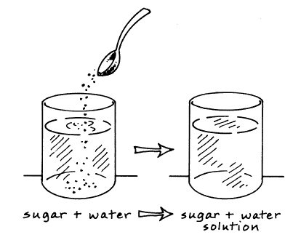
What is a solution?
A solution are homogeneous mixtures that contain two or more substances called the solute and solvent.
has the same composition, color, density, and even taste throughout.

Slide 3
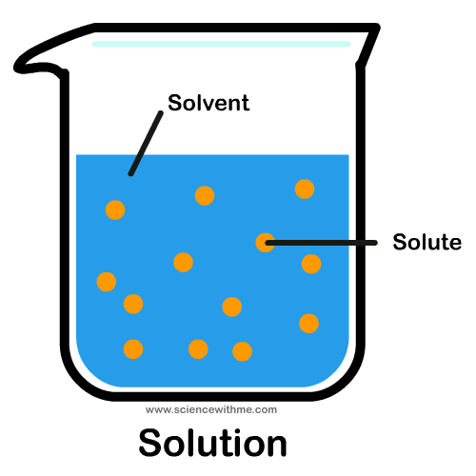
Solutes and Solvents
The substance being dissolved is the solute
The substance doing the dissolving is the solvent

Slide 4
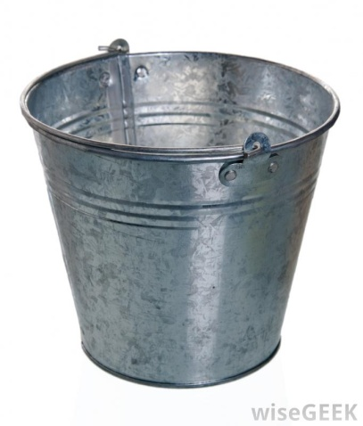
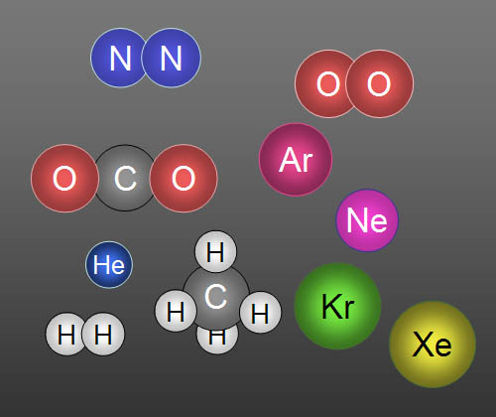
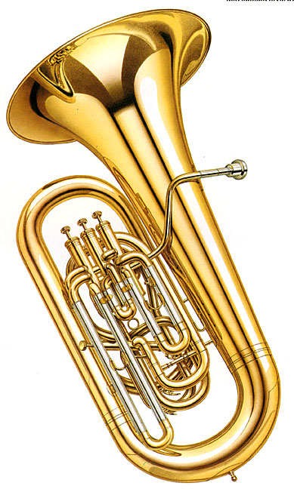
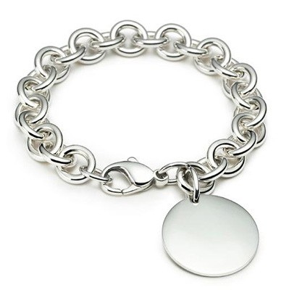
Not all solutions are liquids
Solutions can also be gaseous or even solid.
Examples: air, sterling silver, brass, steel

Slide 5
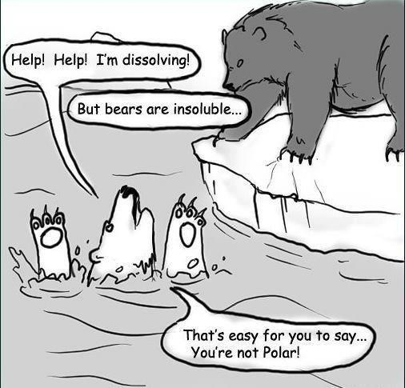
How Substances dissolve
“Like dissolves like”
Polar solvents will dissolve polar solutes
Nonpolar solvents will dissolve nonpolar solutes
Two liquids that are soluble in each other in any proportion are miscible.
Two liquids that can be mixed but separate shortly after are immiscible.

Slide 6
Universal Solvent
Water is known as the “Universal Solvent” because it can dissolve so many things.
Nonpolar solvents examples: mineral oil, gasoline, dry cleaning chemicals

Slide 7
Solubility
Chapter 22.2

Slide 8
Rate of Dissolving
To speed up the rate of dissolving:
Stir
Increase surface area
Increase temperature

Slide 9
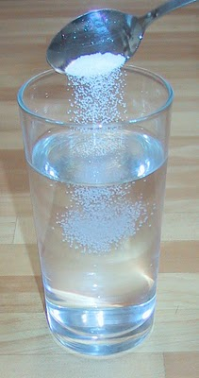
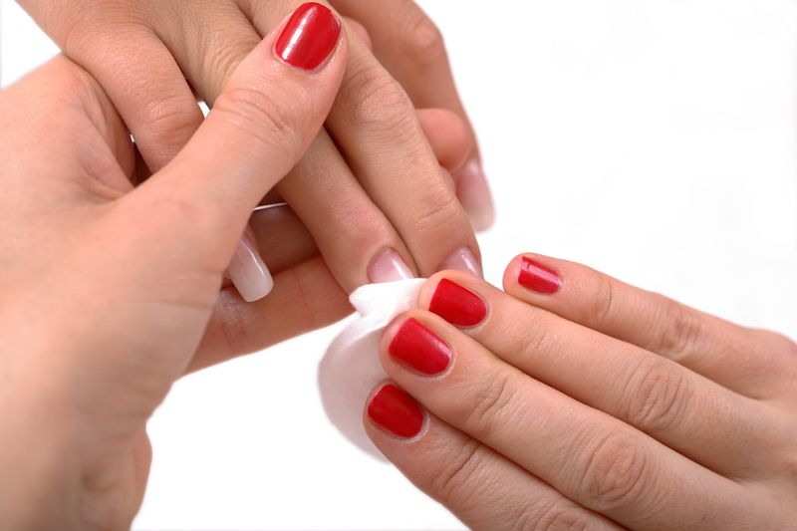
Solubility
Solubility is the amount of a solute that will dissolve in a given amount of solvent
When a substance dissolves in another substance, it is said to be soluble

Slide 10
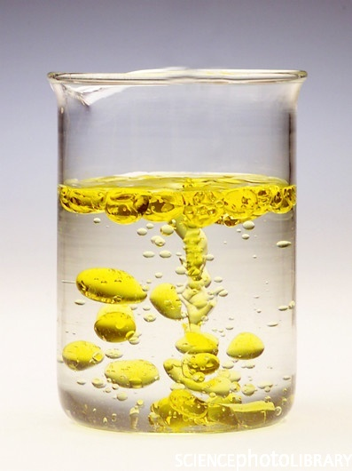
Solubility
When a substance will not dissolve in another substance, it is said to be insoluble

Slide 11
Types of Solutions
Unsaturated Solution – a solution that can dissolve more solute at a given temperature
Saturated Solution – a solution that has dissolved all of the solute it can normally hold at a given temperature
Supersaturated Solution – a solution that contains more solute than a saturated solution at that temperature.

Slide 12
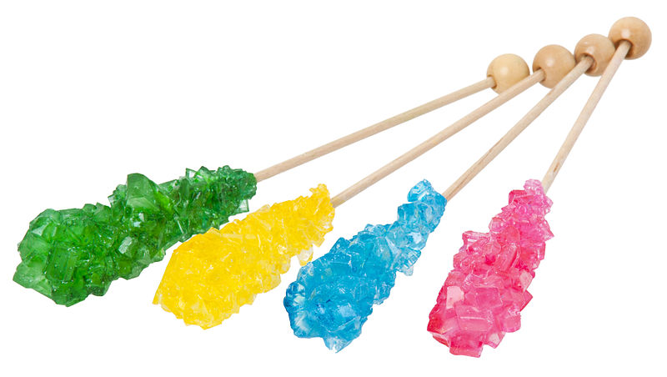
Types of Solutions
Supersaturated Solution – a solution that contains more solute than a saturated solution at that temperature.

Slide 13
Temperature and Solubility
The temperature of the solution affects how much of the solute is dissolved by the solvent.
Increasing the temperature does not always increase the solubility.
Solubility curves are used to show how the solubility of a substance changes with temperature.

Slide 14
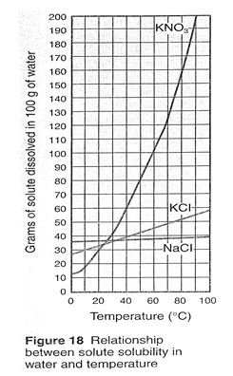
To read the graph, find the line for the substance. The amount that dissolves at a given temperature is on the y-axis.

Slide 15
What kind of solution do you have?
Below the line is unsaturated.
A point on the line is a saturated solution.
Above the line is supersaturated.

Slide 17
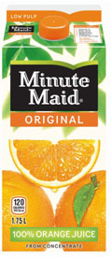
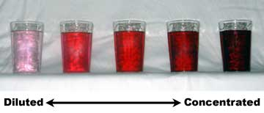
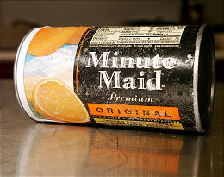
Concentration
A concentrated solution is one in which a large amount of solute is dissolved in the solvent.
A dilute solution is one that has a small amount of solute in the solvent

Slide 18
Solubility of Gases
How do you dissolve more gas into a liquid?
Increase pressure of the gas over the liquid
Decrease the temperature of the liquid

Slide 19
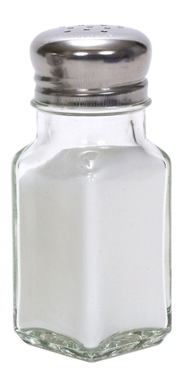
Particles with a Charge
Ion – charged particle that has either more or fewer electrons than protons
The compounds that produce solutions of ions that conduct electricity in water are known as electrolytes
Example: salt

Slide 20
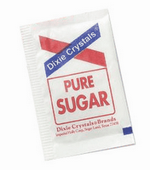
Particles with a charge
Substances that don’t form ions in water and cannot conduct electricity are called nonelectrolytes
Example:
Sugar
Ethanol

Slide 21
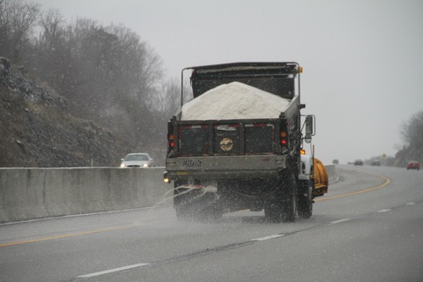
Effects of Solute Particles
All solute particles affect the physical properties of the solvent.
Lowers the freezing point of the solvent
It would freeze at a lower temperature
Examples: antifreeze, salt on winter roads
Increases boiling point
It would boil at a higher temperature

