Slide 1
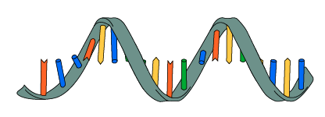
RNA and Protein Synthesis

Slide 2
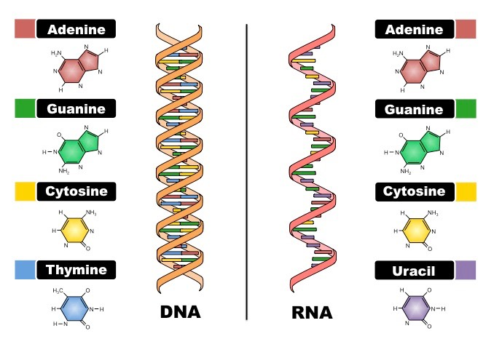
3 Main Differences between RNA and DNA
DNA
Sugar is called deoxyribose
Double stranded
Contains adenine, thymine, guanine, cytosine
RNA
Sugar is called Ribose
Single stranded
Contains adenine, uracil, guanine, and cytosine

Slide 3
3 Types of RNA
Messenger RNA (mRNA)- disposable copy of DNA to carry instructions to assemble proteins at the ribosome
Ribosomal RNA (rRNA)- RNA inside the ribosome to make the ribosome exist
Transfer RNA (tRNA)- transfers amino acids in the cytoplasm to the growing polypeptide chain in the ribosomes to construct proteins

Slide 4
Protein Synthesis
The process of converting mRNA into protein. It is the process of how proteins are made.
Protein Synthesis has 2 Steps:
Transcription
-takes place in the nucleus
2. Translation
- takes place in ribosomes

Slide 5
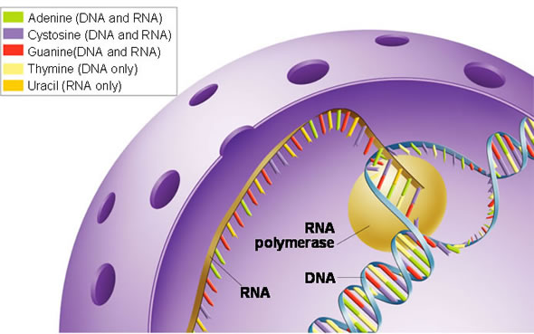
Transcription
Converts a DNA strand into a single- stranded mRNA molecule.
In other words, transcription is the process that copies DNA to make a strand of mRNA
Takes place in the nucleus

Slide 6
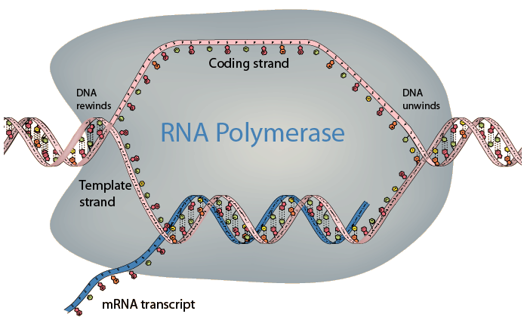
Transcription Continued
Begins at specific locations on DNA called promoters
Enzyme called RNA polymerase seperates DNA strand by breaking hydrogen bonds between nucleotide pairs.
Seperated DNA strands are used as a template to assemble a strand of mRNA

Slide 7
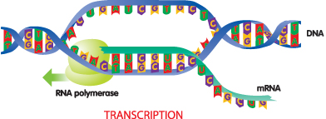
Transcription Continued
Nucleotides pair with one template strand of DNA
RNA polymerase bonds the nucleotides back together
What type of bonds are those?
The DNA helix winds again as the gene is transcribed

Slide 8
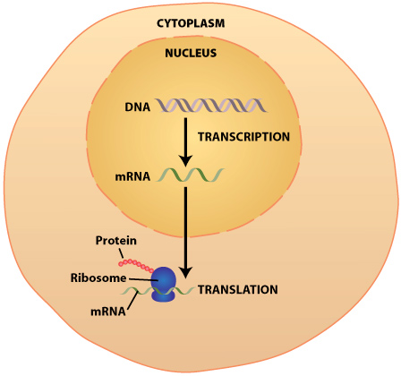
Transcription Continued
The mRNA strand detaches from the DNA one the gene is transcribed
mRNA will leave the nucleus to find a ribosome in the cytoplasm or on the rough endoplasmic reticulum
This event marks the end of transcription and the beginning of translation

Slide 9
Transcription is Similar to Replication
Both involve complex enzymes and complementary base pairing
The two processes have differing results
Replication copies the DNA, but transcription copies only a specific gene on the DNA stand
Replication makes one copy, but transcription can make many copies

Slide 10
Translation
Converts mRNA into a protein
Translates the language of nucleic acids (nitrogen base sequences) into a language of proteins (amino acids)
Each gene carries a code to make one protein
Genes can be anywhere from 300 to 3000 base pairs long
The code is written in a language with only 4 “letters” on mRNA: A, C, G, U
Code is read 3 letters at a time to make an amino acid. Each 3 letters are known as a Codon

Slide 11
Steps to Translation:
1. mRNA leaves the nucleus and attaches to a ribosome
2. translation begins with tRNA in ribosomes binding to AUG, the start codon, which signals the ribosome to assemble amino acids in a polypeptide chain to create a protein

Slide 12
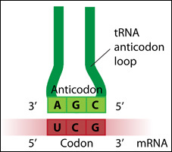
3. each tRNA has an anticodon whose bases are complementary to the codon on mRNA. tRNA brings amino acids to ribosomes and build a polypeptide chain, which creates a protein

Slide 13
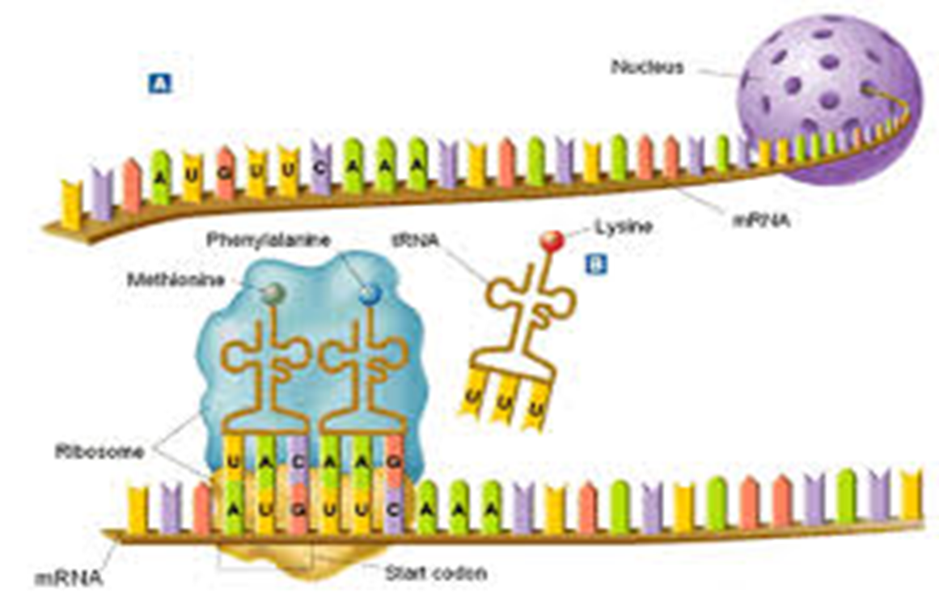
4. the ribosome moves along mRNA and binds new tRNA molecules to mRNA codons and link amino acids together to create a polypeptide chain
*** proteins are held together by peptide bonds

Slide 14
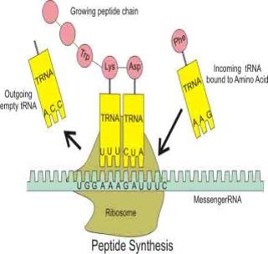
5. the now empty tRNA molecule exits the ribosome
6. a complementary tRNA molecule binds to the next exposed codon

Slide 15
7. the polypeptide chain grows until tRNA reached one of the stop codons (UGA, UAA, UAG).
At the end of translation, the protein is released, folded into a 3D structure, transported in a vesicle to the Golgi Apparatus to be modified and “shipped” to its final destination within the cell or outside of the cell

Slide 16
The Genetic Code
Language of mRNA that tRNA translates to create proteins
Read 3 letters at a time
Example: AUG CCC GGG AUU UGA translates into the following amino acid polypeptide chain: Methionine-Proline-Glycine-Isoleucine-STOP
STOP is not an amino acid. It simply tells tRNA to terminate the translation process and to not add anymore amino acids to the polypeptide chain

Slide 17
Try translating these mRNA to Proteins
AUG UCA AGG GGC CAU UGA
AUG AAA GGG CCC UUU UGA
AUG GAU GCA AUA CUG UGA

Slide 18
The CENTRAL DOGMA includes these 3 processes
1. replication
2. transcription
3. translation
RNA is a link between DNA and proteins

