Slide 1
Properties of Fluids
16.2

Slide 2
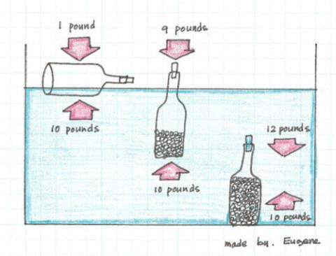
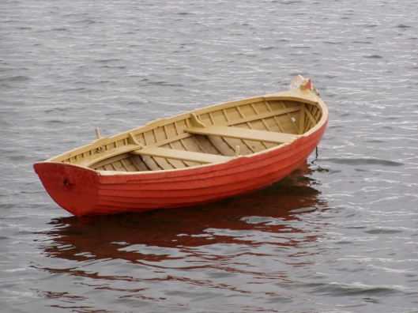
Buoyancy
The ability of a fluid to exert an upward force on an object immersed in it.
buoyant force = object’s weight → object floats
buoyant force less than object’s weight → object sinks.

Slide 3
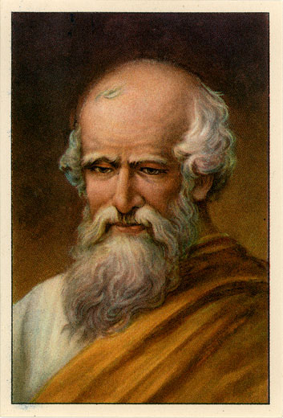
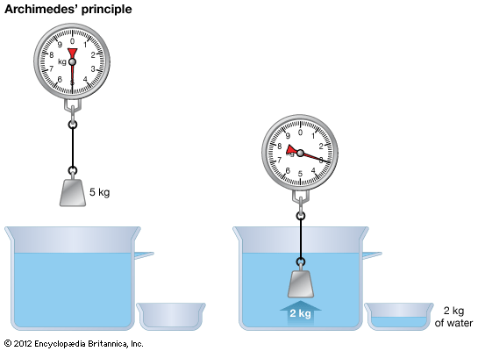
Archimedes’ Principle
The buoyant force on an object is equal to the weight of the fluid displaced by the object

Slide 4
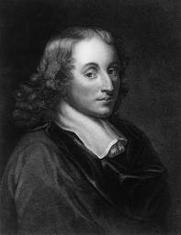
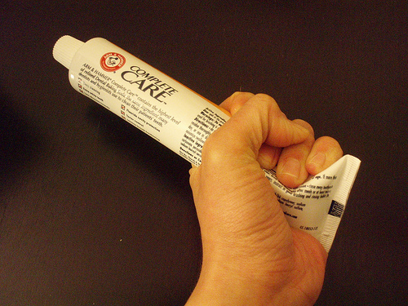
Pascal’s Principle
Pascal’s principle: pressure applied to a fluid is transmitted throughout the fluid
Examples: pushing air around a balloon, or pushing toothpaste to the end of the tube.

Slide 5
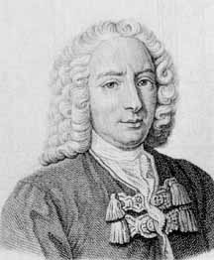
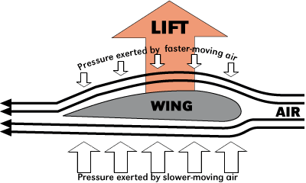
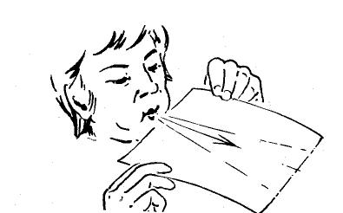
Bernoulli’s Principle
Bernoulli’s Principle: As the velocity of a fluid increases, the pressure exerted by the fluid decreases
Examples: airplanes, Frisbees, blowing across the top of a piece of paper causes the paper to rise

Slide 6
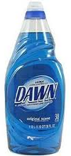
Viscosity
Viscosity is the resistance to flow
Fluids vary in their tendency to flow
Temperature may change the viscosity

Slide 7
Check for understanding
If a buoyant force is less than the weight of an object, will the object float or sink?
If you heat up pancake syrup, will the viscosity of the syrup increase, decrease or stay the same?
Explain Pascal’s principle.

