Slide 1
Population Ecology
How are populations dispersed in areas?
What types of population growth can occur?

Slide 2
Population Density
Number of individuals that live in a defined area
Used to determine the health of the population
Calculated by dividing the # individuals by the area

Slide 3
Population Dispersion
Way individuals of a population are spread in an area or volume
Three types:
Clumped – live close together in groups
Uniform – live at specific distances from each other
Random – spread randomly within an area or volume

Slide 4
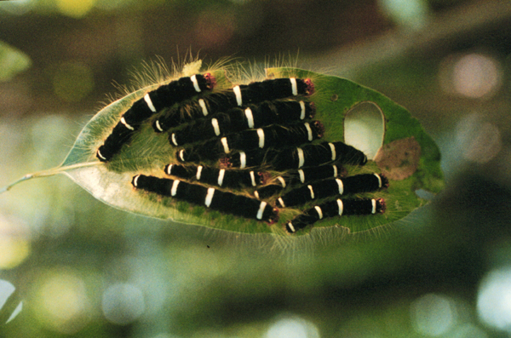
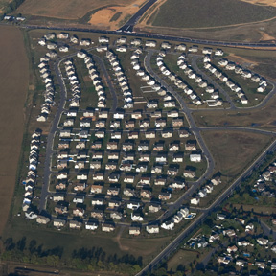
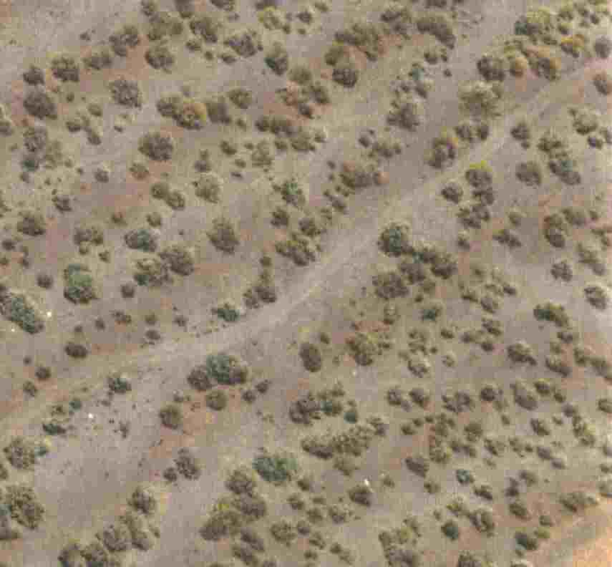
Dispersion Patterns

Slide 5
Population Growth Patterns
Changes in a population’s size are determined by:
Immigration – movement into a population
Births
Emigration - movement out of a population
Deaths
Population growth is based on available resources
Two types of population growth occur:
Exponential growth
Logistic growth

Slide 6
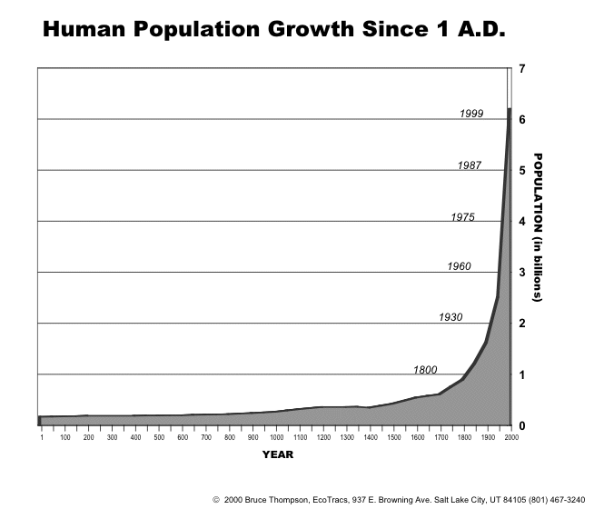
Exponential Growth
Rapid growth as a result of unlimited resources
Appears as a J-shaped curve
Can occur when species is new to an area

Slide 7
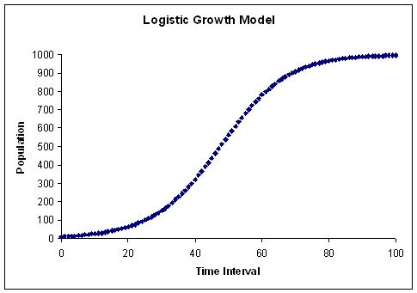
Logistic Growth
Exponential growth followed by a leveling out because of limited resources
Appears as an S-shaped curve
Type of growth that occurs most often

Slide 8
Carrying Capacity
Maximum number of individuals a particular community can support
Based on number of resources available
This creates logistic growth
This number can fluctuate

Slide 9
Limiting Factors
Factor that has the greatest effect in keeping down the size of a population
Density – dependent limiting factors – affected by the number of individuals in a given area
Competition, predation, parasitism and disease
Density – independent limiting factors – limit the population growth regardless of its size
Weather, natural disasters

