Slide 1
Plant Cells and Tissues
What are the cell types and tissues of plants?

Slide 2
Plant Cell Types
Parenchyma cells
Store starch, waters, and oils
Most common
Found throughout plant
Have thin cell walls
Collenchyma cells
Provide support in growing portions of plant because of thicker cell walls

Slide 3
Plant Cell Types
Sclerenchyma cells
Thickest cell walls
Only found in plant where growth is no longer occurring

Slide 4
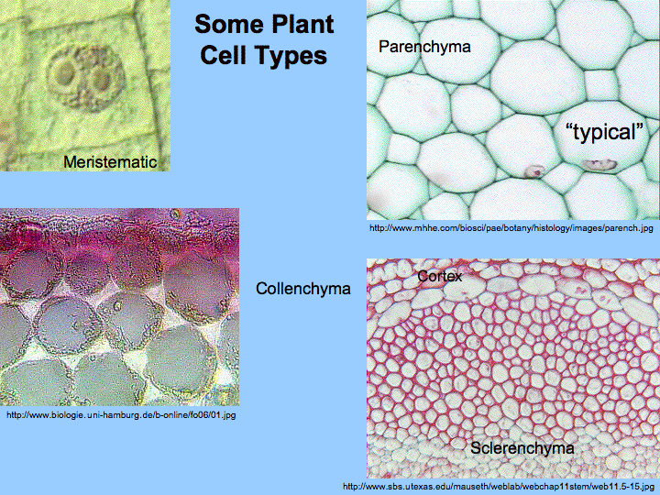
Plant Cell Types

Slide 5
Tissue Systems of Plants
Meristematic Tissue
Where all growth occurs (mitosis)
Dermal Tissue
Outer layer of plant
Ground Tissue
Inside of plant
Vascular Tissue
Xylem – transports water
Phloem – transports sugars

