Slide 1
Warm-up
1. grab an orange periodic table from the back of the room.
Try to identify 2 metals
Try to identify 2 non-metals
Which colum contains noble gasses?

Slide 2
The Periodic Table
Chapter 19

Slide 3
Properties of Metals
Metals are found left of the stair-step line
Metals are usually:
Good conductors of heat and electricity
All but one is solid at room temp. – which one isn’t?
Reflect light (called luster)
Malleable
Ductile

Slide 4
Properties of Metals
Malleable: can be hammered or rolled into sheets
Ductile: can be drawn into wires

Slide 5
Alkali Metals
Found in Group 1
Are shiny, malleable and ductile, good conductors of heat and electricity
Softer than most other metals
Most reactive metals
1 valence electron

Slide 6
Alkaline Earth Metals
Group 2
Similar to all metals: Are shiny, malleable and ductile
Similar to Alkali metals: not found as free elements in nature
2 electrons in its outer shell

Slide 7
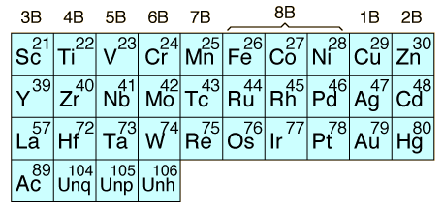
Transition Elements
Elements in groups 3 through 12

Slide 8
Inner Transition Metals
The two rows of elements that seem to be disconnected from the rest of the table are called the inner transition elements
Fit in the periodic table between groups 3 and 4
Lanthanide series and Actinide series

Slide 9
Nonmetals
Chapter 19.2

Slide 10
Properties of Nonmetals
Nonmetals are
Usually gases or brittle solids at room temperature
Not malleable or ductile
Most do not conduct heat or electricity well
Are not shiny
All by hydrogen are locate to the right of the stair step line

Slide 11
Halogens
Group 17
Very reactive in their elemental form
Have 7 valence electrons

Slide 12
Noble Gases
Group 18
Exists as isolated atoms
Are stable because their outermost energy levels are full (they have 8 electrons in them)

Slide 13
Metalloids
Chapter 19.3

Slide 14
Properties of Metalloids
Metalloids:
Form ionic and covalent bonds with other elements
can have metallic and nonmetallic properties
Are located along the stair step line

Slide 15
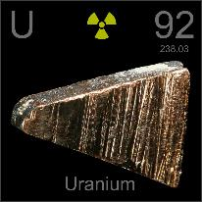
Synthetic Elements
Are made by scientists by smashing particles into atoms
Very unstable
Include Technetium 43 and Promethium 61 and elements has an atomic number 93 and higher
They do not exclusively belong to the metal, nonmetal or metalloid group

