Slide 1
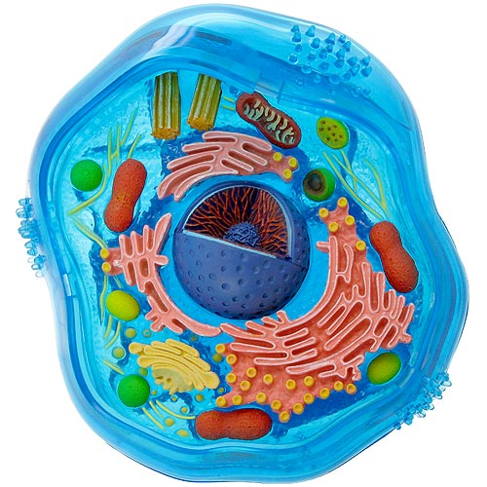
Organelles of Eukaryotes
Cells, Cell, their made of Organelles!

Slide 2
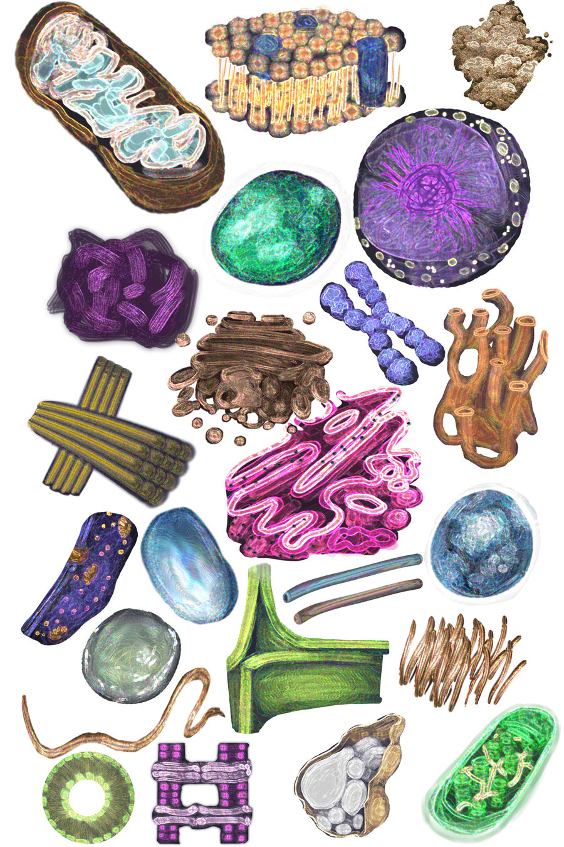
Organelle
A small part that carries out a specific job in a cell

Slide 3
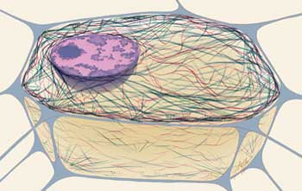
Internal Structure of a Cell
Cytoskeleton
The framework of a cell
Made up of a network of protein fibers
Gives shape, support, and strength to the cell

Slide 4
Organelles Involved in Making Proteins
Nucleus
Stores and protects the DNA of the cell
Endoplasmic Reticulum
A network of thin, folded membranes that helps
in the production of proteins and other molecules
Smooth ER and rough ER(bumps from ribosomes)
Ribosomes
Link amino acids together to form proteins
Found on rough ER and in cytoplasm
Golgi Apparatus
Proteins are modified, packaged into vesicles, and transported to the target destination
Vesicles
Small sacs that carry molecules to where they are needed

Slide 5
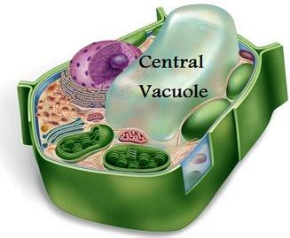
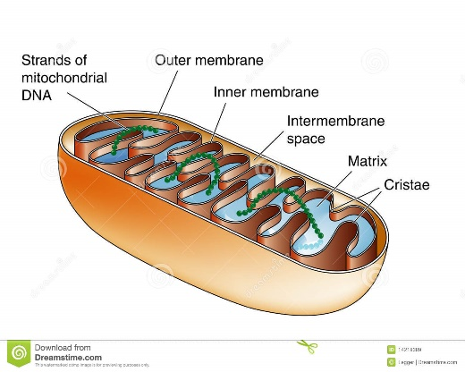
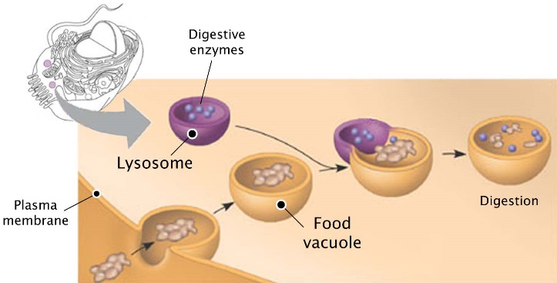
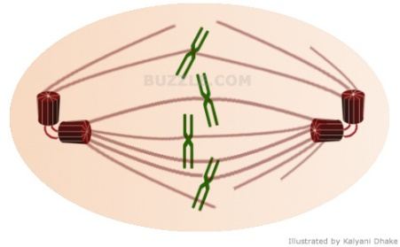
Organelles with Various Functions
Cell Membrane
Forms a boundary between the cell and the outside world
Made up of phospholipids
Mitochondria
Produce chemical energy
Have a double membrane
Have their own ribosomes and DNA
Vacuoles
Fluid filled sacs that hold water, food molecules, ions, and enzymes
Lysosomes
Contain enzymes that attack bacteria and viruses and break down old cell parts
Centrioles
Made of tiny tubes in a circle
Help form cilia or flagella for movement of the cell
Involved in developing spindle fibers for cell division (mitosis)

Slide 6
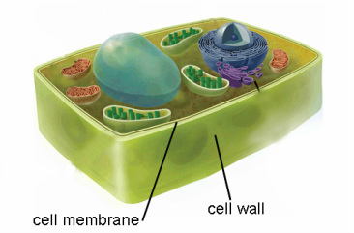
Organelles Only Found in Plants
Cell Wall
Strong, rigid layer that protects, supports, and shapes a plant cell
Surrounds the cell membrane
Chloroplasts
Carry out photosynthesis that stores energy from sunlight as chemical energy for the plant

