Slide 1
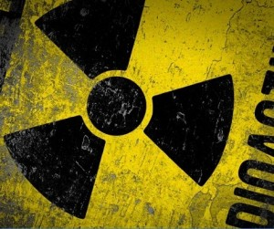
Radioactivity
Chapter 18

Slide 2
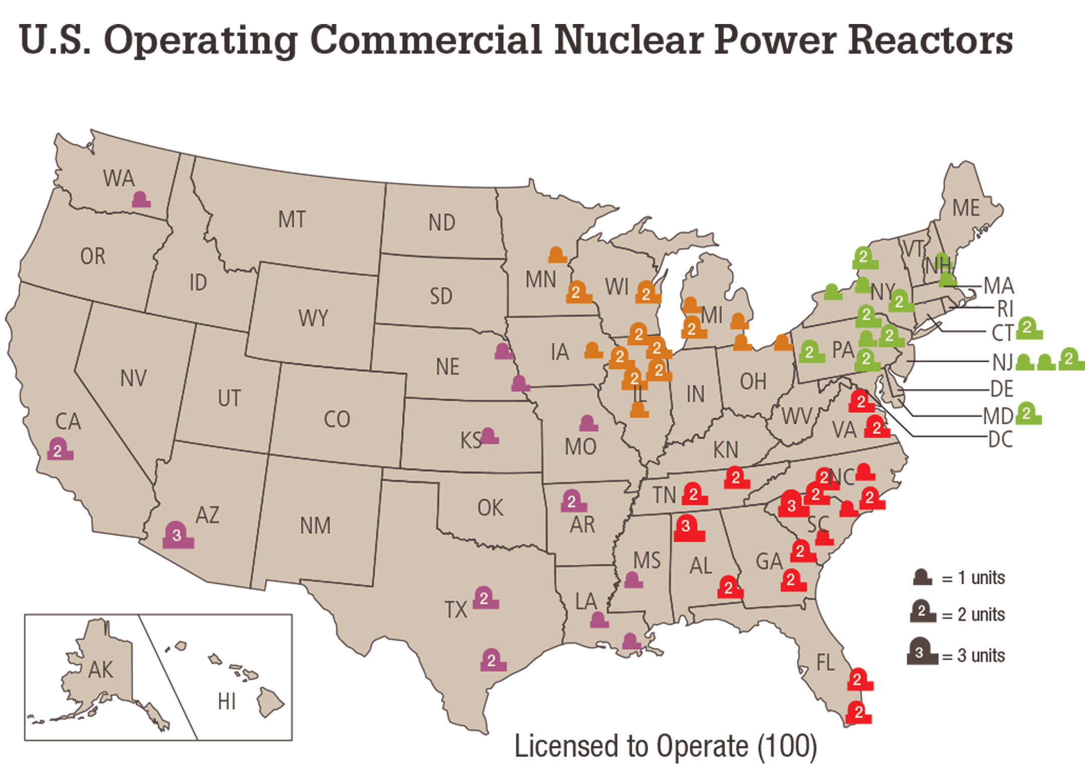

Slide 3
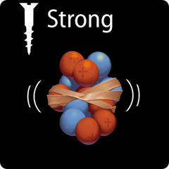
What holds the nucleus together?
Strong force: attractive force that acts between protons and neutrons in an atomic nucleus

Slide 4
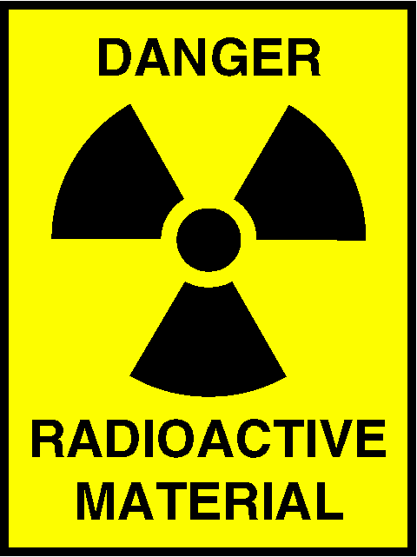
What is radioactivity?
When the strong force is not large enough to hold a nucleus together tightly, the nucleus can decay and give off matter and energy.
This process of nuclear decay is called radioactivity.

Slide 5
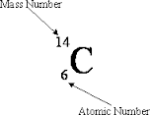
Isotopes
All atoms of an element have the same number of protons.
An Isotope is an atom that has different amount of neutrons.
Ex: Carbon can have 6, 7, or 8 neutrons.
In order to know what carbon we are talking about, we must specify the mass or use isotopic notation.
Carbon 14 can be written as

Slide 6
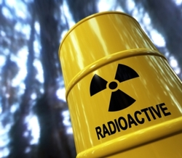
Types of Decay

Slide 7
Alpha Decay
Made of 2 protons and 2 neutrons
Charge of +2
Are more massive than gamma and beta
Can be stopped by a sheet of paper
Alpha particle =
+

Slide 8
Beta Decay
Beta particle =
e
An unstable neutron decays into a proton and emits an electron
This electron is called a beta particle
Faster than alpha particles
Can be stopped by aluminum foil
Charge = -1
+
e

Slide 9
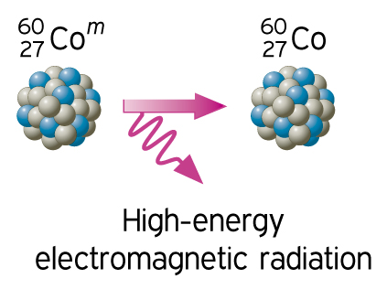
Gamma Rays
Gamma rays are usually emitted from a nucleus when alpha decay or beta decay occurs
Are electromagnetic waves
They have no mass and no charge and travel at the speed of light
Can be stopped by thick blocks of lead or concrete
Have no charge

