Slide 1
The Metric System

Slide 2
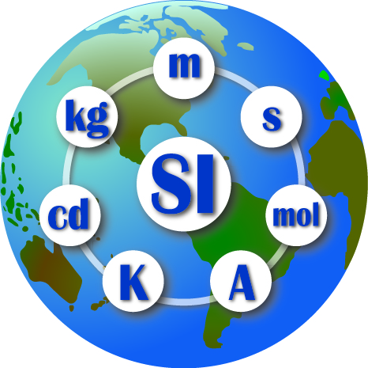
Units and Standards
Standard: an exact quantity that people agree to use to compare measurements
SI = Systeme Internationale d’Unites
All SI standards are universally accepted and understood by scientists throughout the world

Slide 3
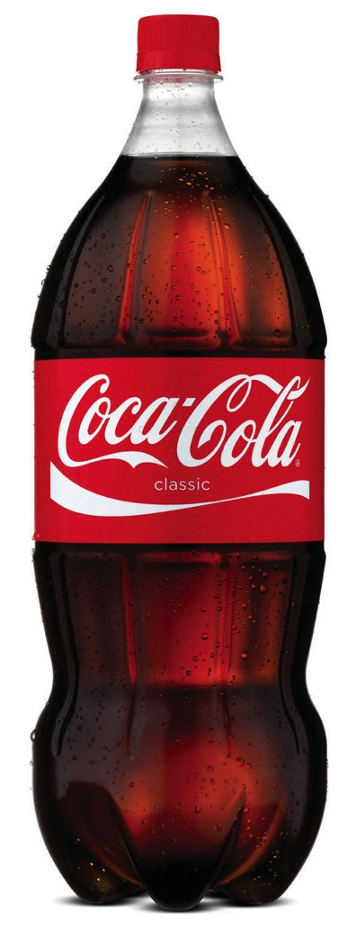
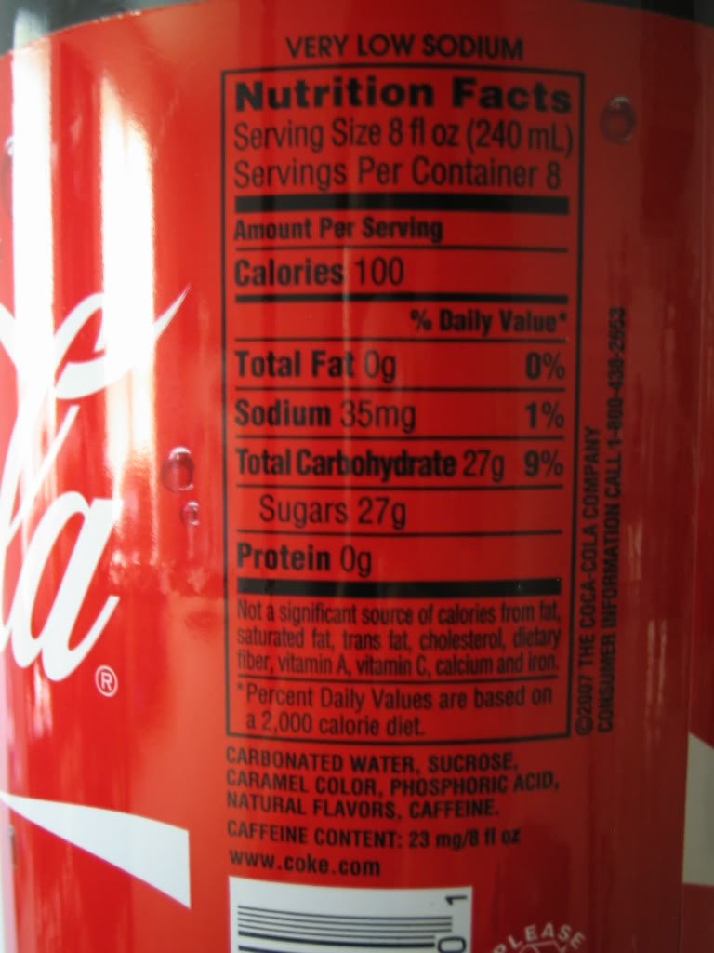
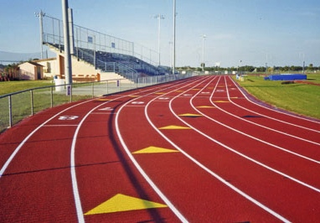
Bases
Three bases we will be using are gram, liter, and meter

Slide 4
King Henry Died ….???
All other SI units are based off the base unit using prefixes
 | Prefix | abbreviation
King | Kilo- | k
Henry | Hecto- | h
Died | Deca- (deka-) | Da or D
By | BASE (gram, liter or meter) | g, L, or m
Drinking | Deci- | d
Chocolate | Centi- | c
Milk | Milli- | m

Slide 5
Convert 12.54 kilometers to centimeters
The answer is 1,254,000 centimeters

Slide 6
457 milliliters to hectoliters
The answer is 0.00457 hL

Slide 7
Check for understanding: Converting between SI units
If you are measuring the volume of a swimming pool, which of the following units would be the best to use? A. mg B. deciliters c. Kiloliters d. meters
Convert 1.255L to milliliters?
Which is bigger: 14.6 hg or 146.7 dg?

