Slide 1
Meiosis
What is the difference between an autosome and a sex chromosome?
How are gametes formed?

Slide 2
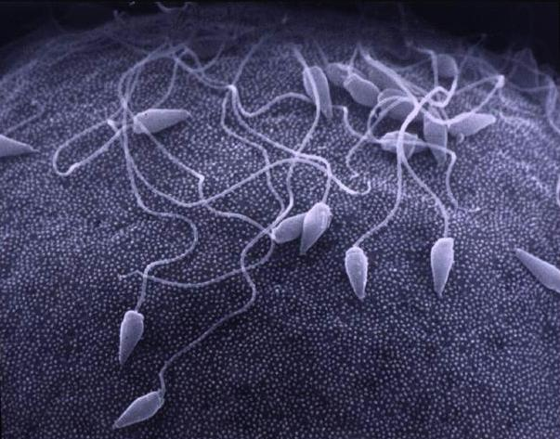
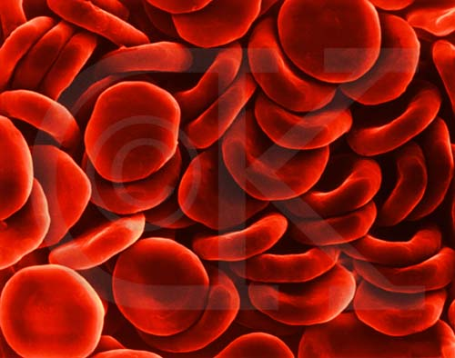
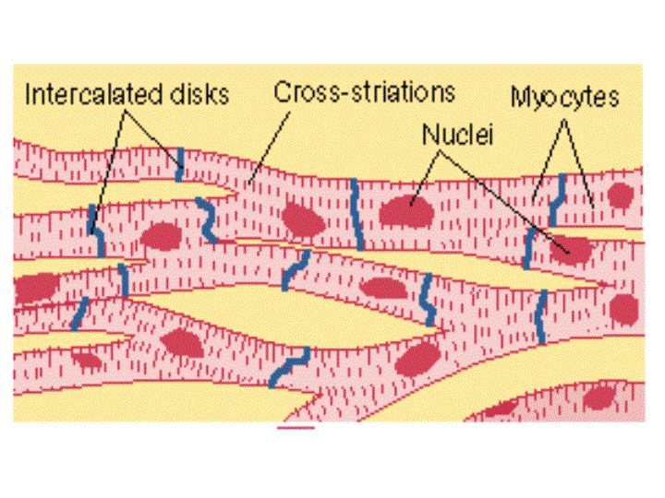
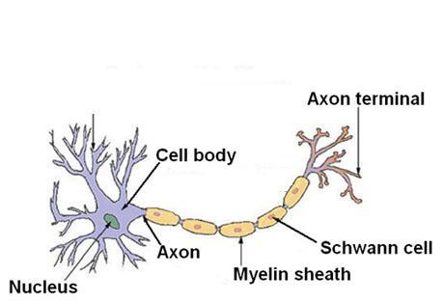
Somatic Cells vs. Gametes
Our bodies have two types of cells:
Somatic Cells – body cells
Gametes – sex cells (sperm and egg)

Slide 3
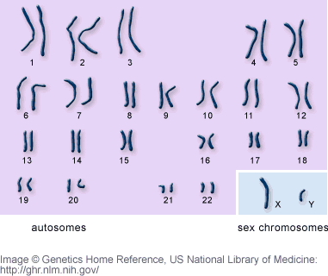
Chromosomes
Our cells have 23 pairs of chromosomes
Pairs are arranged as homologous chromosomes
Chromosomes are either
Autosomes – 22 pairs
Sex chromosomes –
determine gender (1 pair)

Slide 4
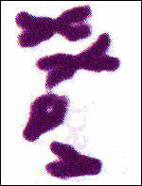
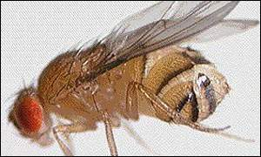
Chromosomes
All organisms have 1 copy of each chromosome from each parent (2 copies – diploid- 2N)
Example: Drosophila has 8 chromosomes (4 from male parent and 4 from female parent) 2N = 8
The gametes of these organisms only contain 1 set of chromosomes. These cells are haploid (1N)
Example: Drosophila gamete (sex) cells – N = 4

Slide 5
Chromosomes and Meiosis
Somatic (Body) cells are diploid
Contain two sets of chromosomes
Gametes (Sex) cells are haploid
Contain one set of chromosomes
Cells go from diploid to haploid through meiosis
Purpose of meiosis is to create gametes
Meiosis is the process where the number of chromosomes per cell is cut in half by separating homologous chromosomes in diploid cell

Slide 6
Meiosis Videos
cells alive meiosis phases
Meiosis Video

