Slide 1
Lewis Structures

Slide 2
Lewis Dot Diagrams
Electron dot diagrams represent the electrons in the outer energy level.
Outer energy electrons are also called valance electrons.

Slide 3
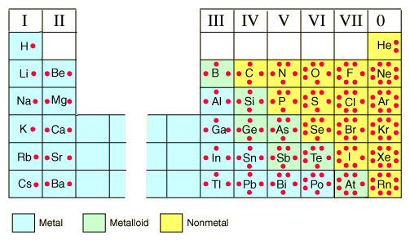
Helpful hint:
There is a pattern – the column the element is in tells you how many valence electrons an atom has
exceptions: transition metals and helium

Slide 4
How to write an Lewis Structure:
Write the element symbol
Place a the appropriate # of dots around the symbol (max. of 8)
Start by putting one dot on each side of the symbol, if it is greater than 4 then put two dots per side. (no more than 2 per side)

Slide 5
Now you try!
Write the lewis dot structure for the following elements
O
Na
Ar

