Slide 1
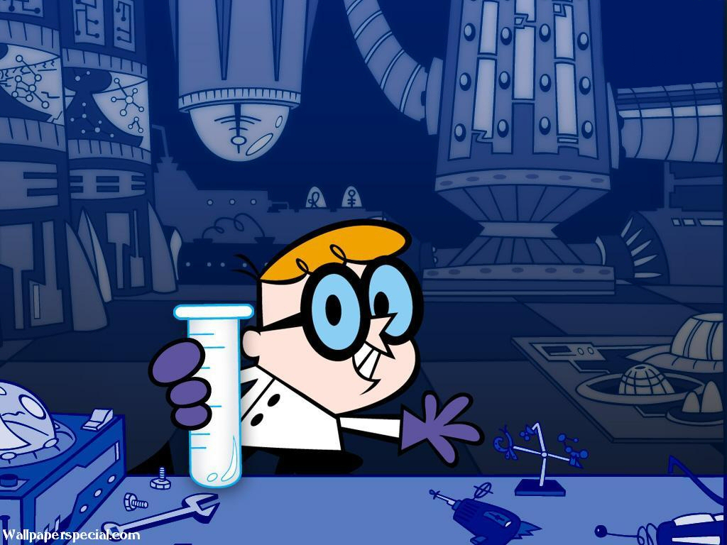
Lab Safety

Slide 2
Lab Rules
Always read through the lab instructions before beginning the lab
Food and drink must be put away during labs
Keep aisles clear – put bags out of the way

Slide 3
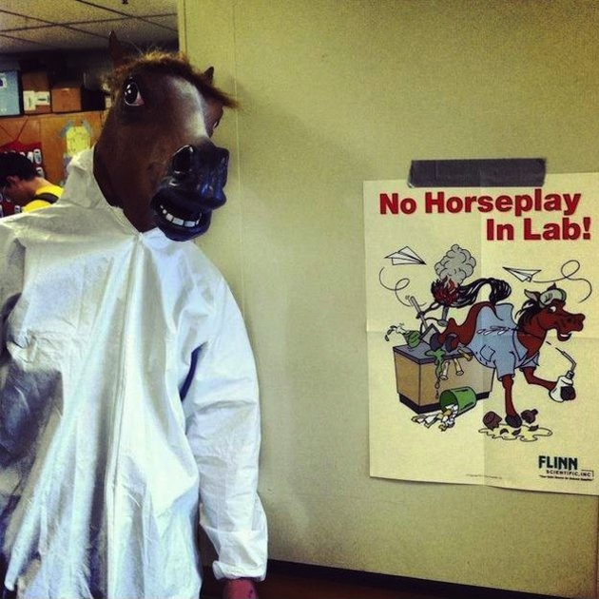
Lab Rules
No horseplay or goofing off during labs.
Can result in accidents and spills
Can result in injury
And can result in an office referral

Slide 4
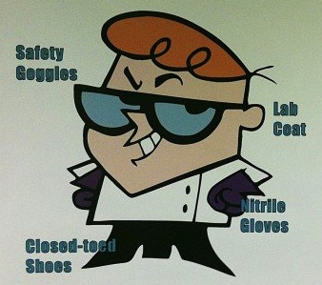
Attire
Depending on the lab you may be required to wear the following:
Goggles
Gloves
Lab Apron
No loose clothing (ex. Scarf, long necklaces, loose sleeves)
Closed toed shoes
Tie long hair back

Slide 5
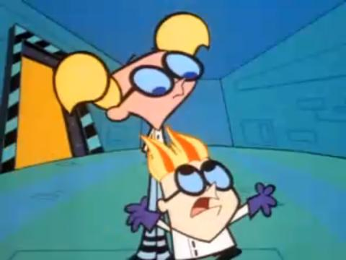
In case of a fire:
Know where the following are located:
Eyewash station and safety shower
Fire blanket
Fire extinguisher

Slide 6
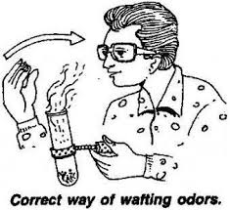
Working with Chemicals
Never look directly into a test tube
Point test tubes away from you and others when you are heating them
To smell a substance, WAFT it towards your face
NEVER TASTE ANYTHING DURING THE LAB

Slide 7
What do you do when…..?
You spill something– Notify the teacher and she will direct you on how to clean up the spill properly
You break a beaker/test tube – Notify the teacher immediately, Do not clean it up your self
You injury yourself – no matter how minor, always notify your teacher
Your lab partner gets injured, faints, or has some other medical issue – notify the teacher immediately.

Slide 8
What do you do when…..?
You’re not sure what to do on one of the steps of the lab – 1) Reread all of the lab procedures 2) Ask a neighbor group for clarification 3) Ask your teacher for clarification
You’re done with the lab – Clean up your table and return equipment to the proper location. Follow any specific clean up instructions.

Slide 9
Check for understanding
Determine whether the following statements are true or false:
Eating a snack during lab is okay as long as you share.
Unless told otherwise, it is totally okay to taste lab supplies.
If a piece of glassware gets broken, you should notify the teacher so that he or she can clean it up safely.
In order to smell something during a lab you should take a gigantic sniff of it

