Slide 2
Karyotypes
Karyotypes=photographs that show an individual’s chromosomes in homologous pairs.
Karyotypes are used to locate abnormalities in shape or number of chromosomes.
Cells are isolated during metaphase, all the chromosomes are stained, and then photographed. The photograph is then cut apart and placed in homologous pairs from longest to shortest.

Slide 3
Karyotypes cont.
This is a karyotype of a normal male.
Notice all the chromosomes are matched with their homologous pair.
Notice the sex chromosomes. The X chromosome is much longer than the Y chromosome.

Slide 4
Karyotypes cont.
Notice the 21st chromosomes.
There are three instead of a pair. This is called trisomy.
Trisomy on the 21st pair causes Down’s Syndrome.

Slide 5
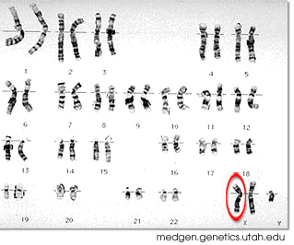
Karyotypes cont.
This person’s sex chromosomes are XXY.
Are they male or female?
This type of abnormality causes Klinefelter’s Syndrome.

Slide 6
Mutations
There are two types of mutations:
Gene mutations occur when there is any change in the DNA. This would be a change in a single gene.
Chromosomal mutations occur when there is a change in the chromosome number or chromosomal structure. This would be a change in a whole chromosome.

Slide 7
Mutations cont.
There are two types of gene mutations:
1. Point mutations are a change in a single base pair of one DNA codon.
TAC ATA GTA GCC
(methionine)(tyrosine) (histidine)(arginine)
TAC ATA GAA GCC
(methionine) (tyrosine) (leucine) (arginine)
The whole protein is changed when one base is changed.

Slide 8
Mutations cont.
2. Frameshift mutations are the addition or deletion of a single base in a codon.
AUG AAG UUU GGC
← SHIFT
AUG AAU UUG GC
Three amino acids will be created instead of four and different amino acids than were intended.

Slide 9
Mutations cont.
There are six types of chromosomal mutations:
Nondisjunction occurs when homologous chromosomes do not separate during meiosis causing trisomy or monosomy.
Refer to Down’s syndrome and Klinefleter’s syndrome.

Slide 10
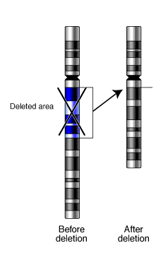
Mutations cont.
Deletion occurs when a segment of a chromosome is left out during replication.

Slide 11
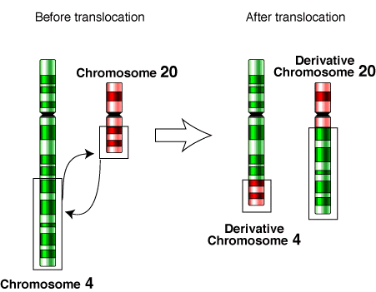
Mutations cont.
3. Translocation occurs when a portion of one chromosome breaks off and reattaches to a different chromosome.

Slide 12
Mutations cont.
4. Insertion occurs when a portion of a chromosome breaks off and inserts itself into another chromosome.

Slide 13
Mutations cont.
5. Duplication occurs when a segment of a chromosome is repeated.

Slide 14
Mutations cont.
6. Inversion occurs when a portion of a chromosome breaks off and reattaches backward.

Slide 15
Diagnose
Abcdefghijklm→abcijklm
Abcdefghijklm→abihgfedcjklm
Abcdefghijklm→abcdefdefghijklm
Abcdefghijklm→abcdefghijklmwxyz

Slide 16
Genetic Engineering
Genetic Engineering=making changes in the DNA code of living organisms.
Types of Genetic Engineering:
Selective Breeding
Hybridization = mating dissimilar organisms
Inbreeding = mating similar organisms
Induce Mutations with chemicals or radiation
Removing DNA, cutting it into fragments with restriction enzymes, or separating it into fragments with gel electrophoresis, and then combining that DNA with other DNA

Slide 17
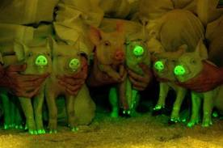
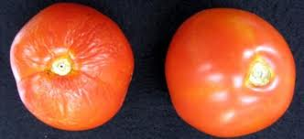
Genetic Engineering cont.
Applications of Genetic Engineering
Dog breeds, horse breeds
Flowers
Transgenic organisms
Bacteria that produces insulin
Lab animals containing human genes can be tested for reactions to new medicines, etc. rather than humans

