Slide 1
Inheritance of Sex-Linked Genes
How are the patterns of inheritance different in sex-linked traits?

Slide 2
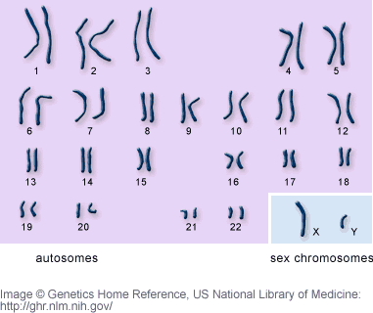
Sex Chromosomes in Humans
X and Y chromosomes determine gender in humans
Females – XX
Males – XY

Slide 3
Sex-Linked Genes
Sex-Linked genes are only present on sex chromosomes (X and Y)
The inheritance pattern is different for these genes depending on gender
Females can inherit two copies of the gene
Males can only inherit one copy of the gene
Example: Colorblindness is recessive
Females – X^{B}X^{B}, X^{B}X^{b}, X^{b}X^{b}
Males – X^{B}Y, X^{b}Y

Slide 4
Sex-Linked Genes
What are the chances for a couple to have a normal vision child if the dad is colorblind and mom is a carrier?
X^{b}Y x X^{B}X^{b}
 | X^{b} | Y
X^{B} | X^{B}X^{b} | X^{B}Y
X^{b} | X^{b}X^{b} | X^{b}Y

Slide 5
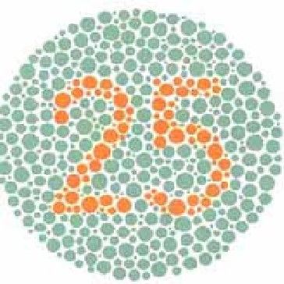
Color Blind Test

Slide 6
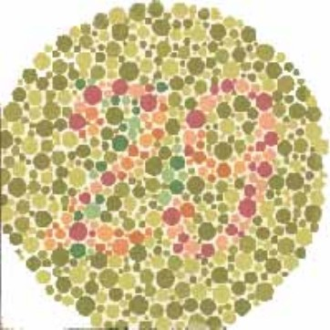
Color Blind Test

Slide 7
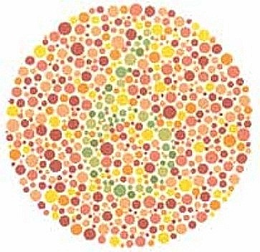
Color Blind Test

Slide 8
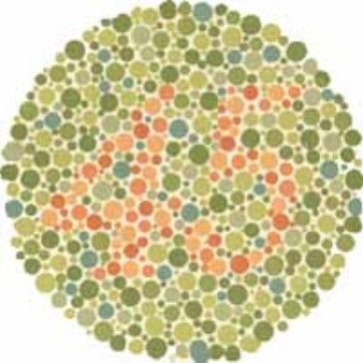
Color Blind Test

Slide 9
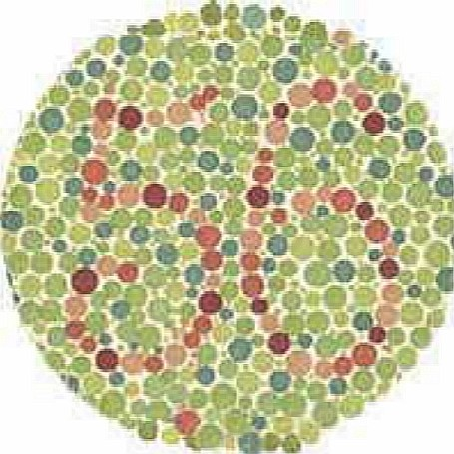
Color Blind Test

Slide 10
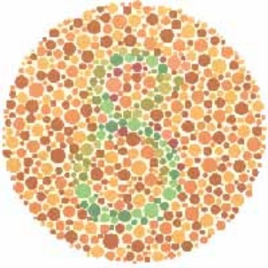
Color Blind Test

Slide 11
X – Chromosome Inactivation
Humans only need one X chromosome to carry out essential functions
In females, the extra X chromosome condenses and moves to edge of nucleus
Traits are only expressed on active X chromosome
Leads to traits differing on organisms
Ex. Calico cats

