Slide 1
Gregor mendel and heredity
What laws did Mendel develop?
How do genes influence the development of traits?

Slide 2
Mendel’s Laws
Genetics – study of inheritance patterns in an organism
Traits – characteristics that are inherited
Mendel established our current understanding of how traits were inherited
He established purebred (or true-breeding) plants to study

Slide 3
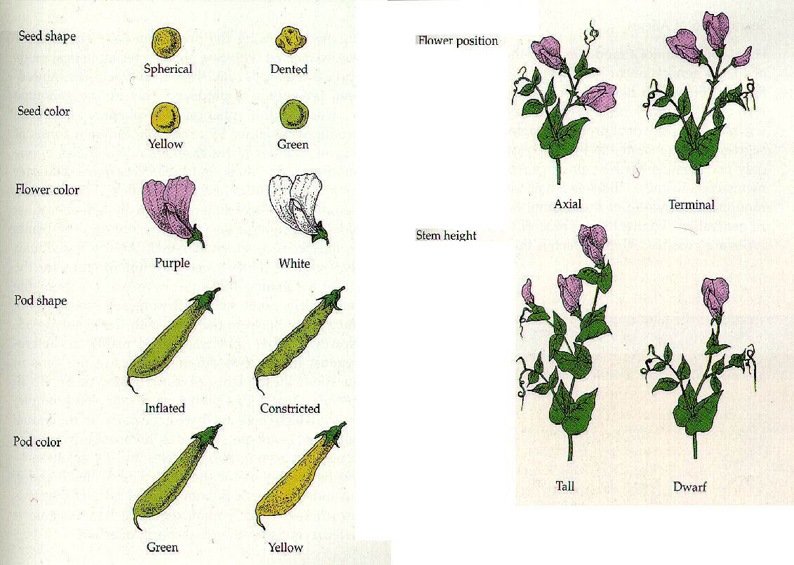

Slide 4
Mendel’s Laws
Mendel crossed these traits with each other and made observations about the offspring
Law of Dominance
Traits are either dominant or recessive
Dominant traits are always visible if present
Recessive traits are only visible if the dominant trait is absent

Slide 5
Mendel’s Laws
Law of Segregation
Organisms inherit two copies of each gene, one from each parent
Organisms donate only one copy to their gametes
This means that genes must separate during gamete formation
(MEIOSIS)

Slide 6
Mendel’s Laws
Organisms can inherit two of the same alleles or different alleles
Homozygous – same alleles – either both dominant or both recessive (AA or aa)
Heterozygous – different alleles – (Aa)

