Slide 1
Genetic Variation Within Populations
How does variation within a population exist?

Slide 2
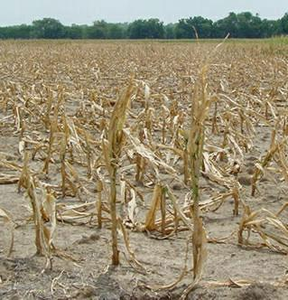
Genetic Variation
A wide range of phenotypes in a population means there is a lot of genetic variation
Genetic variation allows more individuals a chance of survival
More differences, greater likelihood, one adaptation exists to help survival

Slide 3
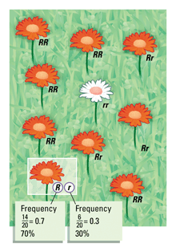
Genetic Variation
Genetic variation is stored in a population’s gene pool
A gene pool contains all of the alleles in a population
How frequently a certain allele occurs in a population is the allele frequency

Slide 4
How does genetic variation occur?
Mutations
Changes in new DNA can form a new allele
Recombination
Crossing over (prophase I of meiosis)
Independent assortment
Random fertilization

Slide 5
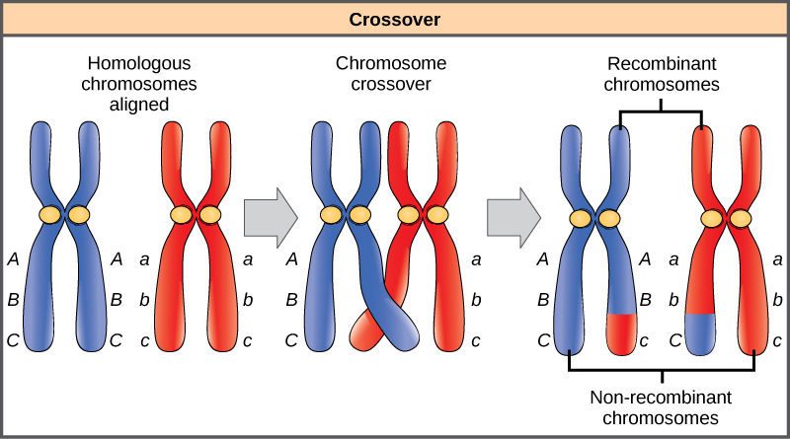
Crossing Over

Slide 6
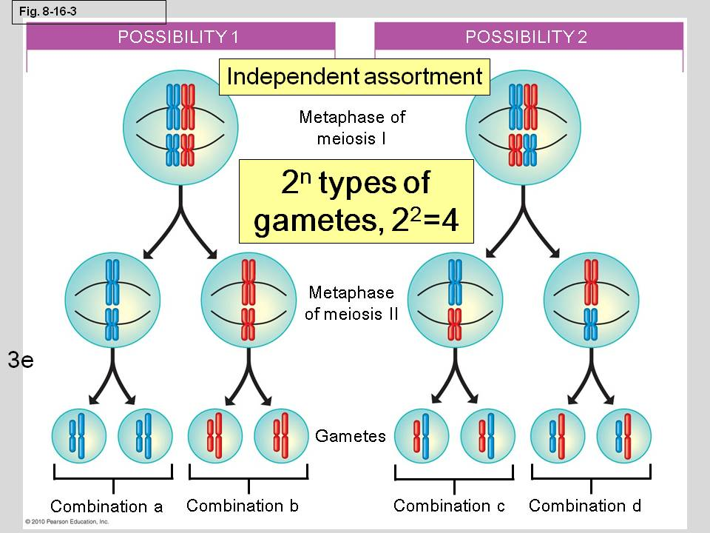
Independent Assortment

