Slide 1
The Food Chain

Slide 2
Producers
Producer=converts sunlight or chemicals into food for themselves
Two types of producer:
Photosynthesizers-convert sunlight into food energy
Chemosynthesizers-convert chemicals into food energy
Producers are also known as autotrophs

Slide 3
Consumers
Consumer=consume food to acquire energy
Five types of consumers:
Herbivores-consume only plants
Carnivores-consume only meat
Omnivores-consume both plants and meat
Detritivores-eat dead matter
Decomposers-eat dead matter and recycle nutrients back into the environment
Consumers are also known as heterotrophs
What is a generalist? What is a specialist?

Slide 4
Food Chains
Food chains show a one way flow of energy through an ecosystem.
Only 10% of energy is passed to the next step
Other 90% is used or lost as heat and waste
Each step is known as a trophic level
Trophic level: level of nourishment in a food chain
Arrows show the flow of energy
2nd order consumer=Small Fish
1st order consumer=Zooplankton
Producer=Algae

Slide 5
Food Webs
Food webs show all the food chains in an ecosystem
Use the following organisms to draw a food web: Hawk, Bacteria, Mouse, Pine Tree, Pine Bug, Snake, Acorn, Kinglet (small bird), Fungi, Salamander
**Don’t forget your arrows to represent energy flow**

Slide 6
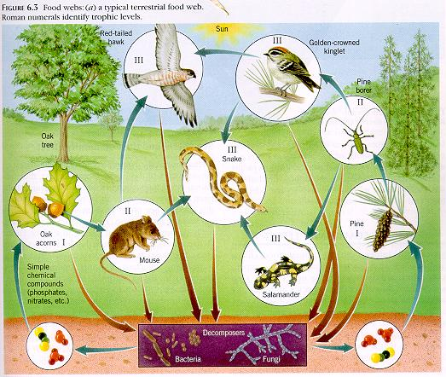
Food Web

