Slide 1
Enzymes
How do catalysts speed up chemical reactions?
How do enzymes function as catalysts?

Slide 2
Catalysts
Activation energy is energy needed to start a chemical reaction
Sometimes the activation energy required is greater than the energy present so a catalyst is required
Catalysts lower the activation energy a reaction needs
Examples of catalysts: heat, stirring, crushing

Slide 3
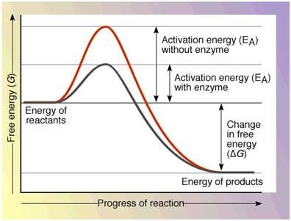

Slide 4
Enzymes Function as Catalysts
Enzymes are catalysts for organisms
They lower the activation energy and increase the rate of reactions
Enzymes are proteins
Their function depends on their shape
Lock/Key analogy
Enzyme binds to substrate
Reaction occurs
Enzyme and Product separate

Slide 5
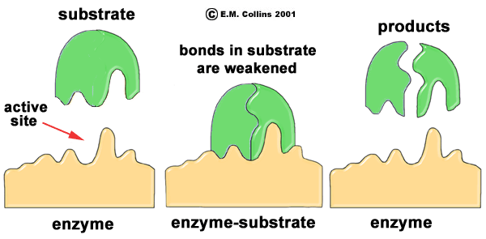

Slide 6
Enzymes Function as Catalysts
Enzymes are:
Specific - they only bind with certain substrates
Affected by their environment – temperature, pH, salinity all affect the shape of the enzyme
Substrates bind to enzymes by attaching to their active sites
The enzyme then bends around the substrate (induced fit)

