Slide 1
Ecology of Fungi
What roles do fungi play in our ecosystem?
How do humans use fungi?

Slide 2
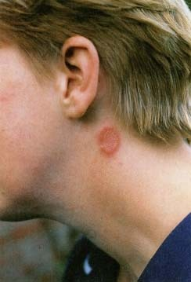
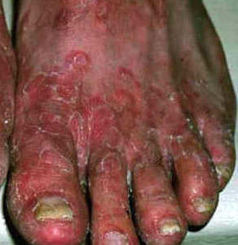
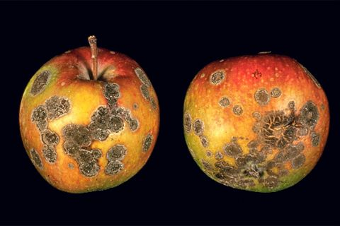
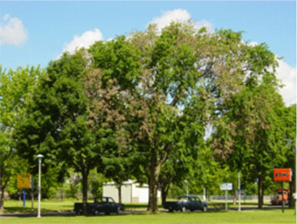
Roles of Fungi
Decomposers
Recycle nutrients back to environment
Pathogens
Human diseases
Yeast infections, ringworm, athlete’s foot
Plant diseases
Dutch Elm disease, scab(peaches), gray mold (strawberries)

Slide 3
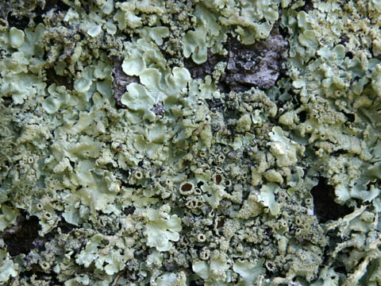
Roles of Fungi
Fungal mutualists
Lichen
Mycorrhizae
Fungi and insects

Slide 4
Human Uses of Fungi
Food
Healthcare
Model organism for studying genome sequence

