Slide 1
Ecological Succession
How do communities change over time after a disturbance?

Slide 2
What is succession?
Succession occurs following a disturbance in a community
Organisms appear in a specific sequence when the community is regenerated
Two types:
Primary Succession
Secondary Succession

Slide 3
Primary Succession
Occurs after exposure or formation of rock
Ex. Glaciers melting, lava flow
Lichen and moss grow (pioneer species)
Dirt accumulates
Grasses
Small Shrubs
Pine trees
Deciduous trees (climax community)

Slide 4
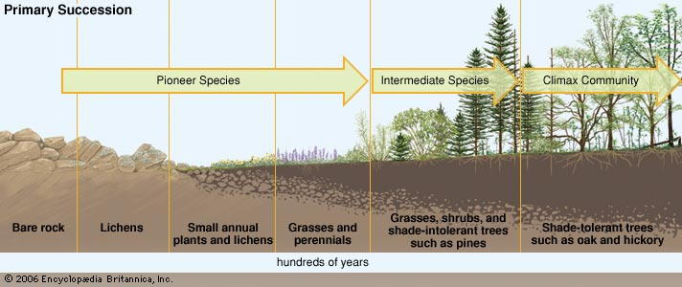
Primary Succession

Slide 5
Secondary Succession
Occurs after land has been cleared
Ex. Natural disasters, abandoned farms
Begins with dirt
Grasses
Small Shrubs
Pine trees
Deciduous trees

Slide 6
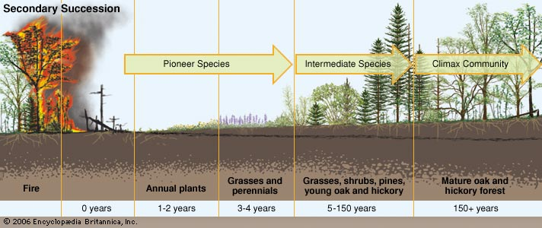
Secondary Succession

