Slide 1
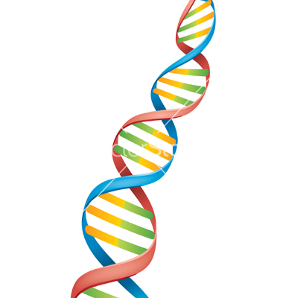
DNA Structure and Replication
Deoxyribonucleicacid

Slide 2
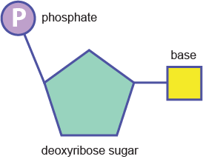
The Structure of DNA
Building blocks of DNA are called NUCLEOTIDES
3 Parts to a nucleotide
5- carbon sugar called DEOXYRIBOSE
A PHOSPHATE GROUP
A NITROGENOUS BASE
( A, T, C, or G)

Slide 3
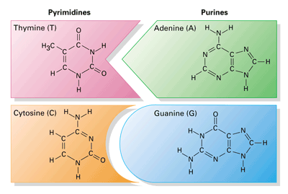
4 Nitrogen containing Bases
Pyrimidines
1. Thymine (T)
2. Cytosine (C)
Purines
3. Adenine (A)
4. Guanine (G)

Slide 4
Double Helix
Double helix backbone
in DNA is formed by
alternating sugar (ribose)
and phosphate groups
Base pairing:
A and T
C and G

Slide 5
Double Helix
The backbone is connected by covalent bonds
The nitrogenous bases are connected by hydrogen bonds

Slide 6
The DNA Molecule

Slide 7
Chargraff’s Rule

Slide 8
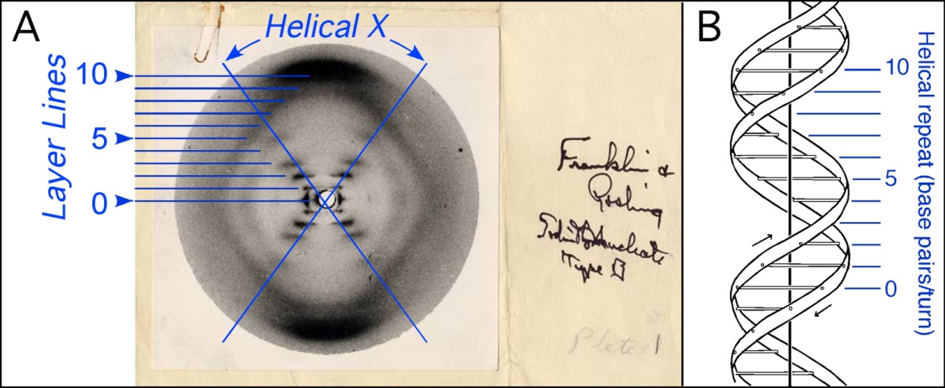
X-Ray diffraction
Rosalind Franklin studied the structure of DNA using X-rays
She produced X-ray diffraction photographs.
This provided evidence that DNA had the following features:
DNA is a helix.
Some portion of the helix is repeated

Slide 9
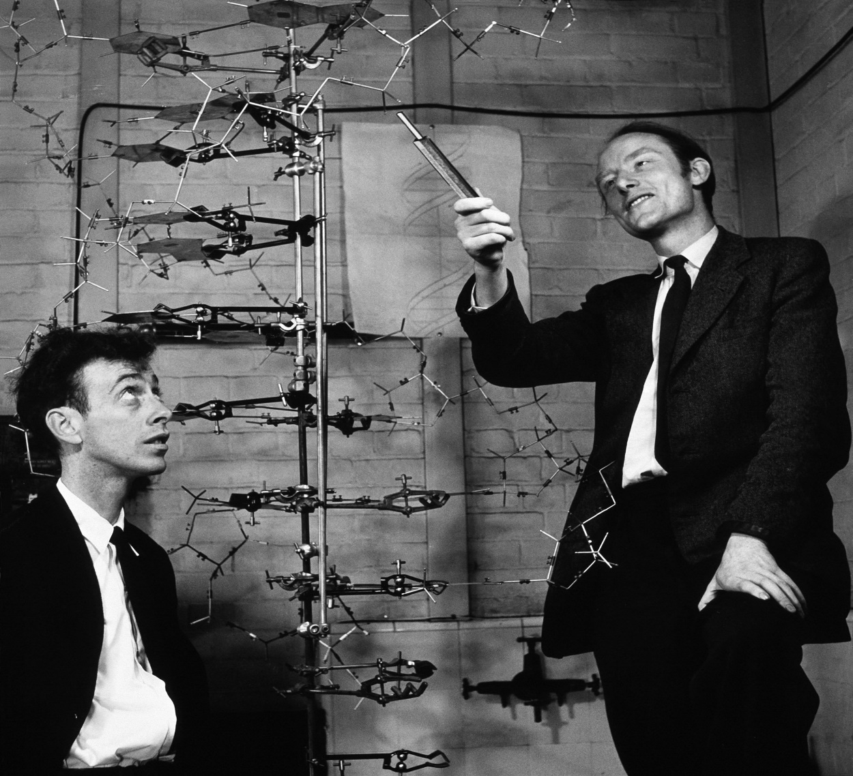
The Double Helix DNA Model
After Looking at Franklin and Chargaff’s work, Watson and Crick constructed the first DNA model in 1953
They realized that DNA is a
double helix that is made
up of an alternating sugar
(ribose) and phosphate
backbone with nitrogenous
bases (A, T, C, G) on the inside
connected by hydrogen bonds

Slide 10
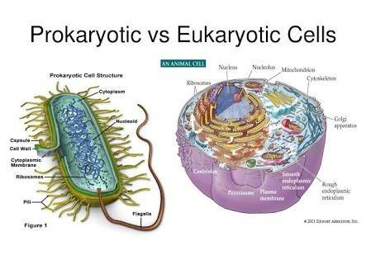
DNA is found in both EUKARYOTIC and PROKARYOTIC cells
Prokaryotic Cells Eukaryotic Cells
DNA located in the DNA located in the
cytoplasm cell nucleus

Slide 11
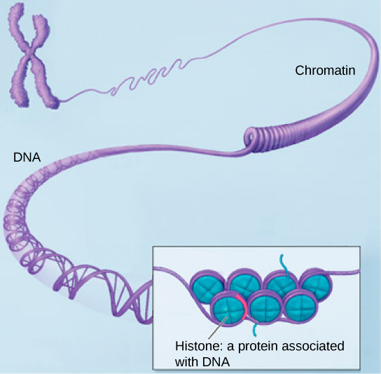
2 Forms of DNA
Chromatin- loose combination of DNA and histones, which are protiens
It is loosely coiled DNA that looks like
noodes
Chromosomes- a single piece of
tightly coiled condensed DNA
containing genes
It looks like the letter X

Slide 12
Assignment
DNA Paper Model

Slide 13
What is DNA Replication?
The process by which a cell copies its DNA
Why does a cell need to copy its DNA?
To prepare for cell division and to create more cells that contain identical strands of DNA
Examples: mitosis and meiosis

Slide 14
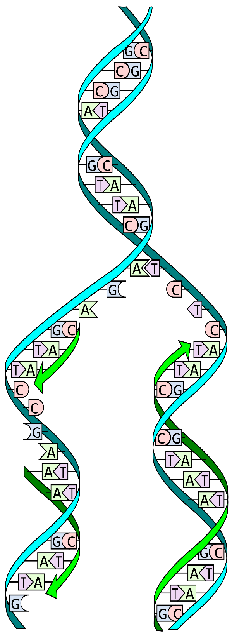
4 Steps to DNA Replication
DNA Polymerase (enzyme) breaks hydrogen bonds between nucleotides to separate DNA into 2 strands. Each original strand of DNA Serves as a template for a new strand
Follow rules of base pairing to replace “missing” bases: A-T and C-G

Slide 15
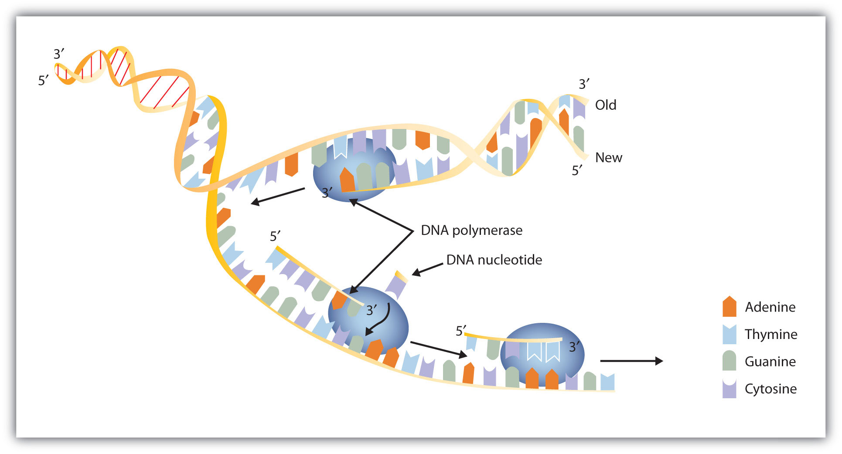
4 Steps to DNA Replication
3. DNA Polymerase bonds to nucleotides together to reform the double helix and edits the DNA for mistakes (The enzyme acts as “molecular scissors”, glue, and an editor)

Slide 16
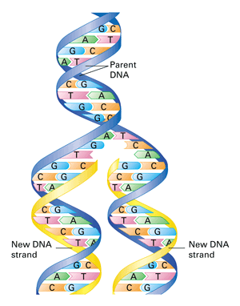
4 Steps to DNA Replication
4. 2 new identical strands of DNA are produced. The DNA is semi conservative: original DNA strands paired with new DNA strand

Slide 17
Assignment
g

