Slide 1
Conservation of Energy
Chapter 4 Section 2

Slide 2
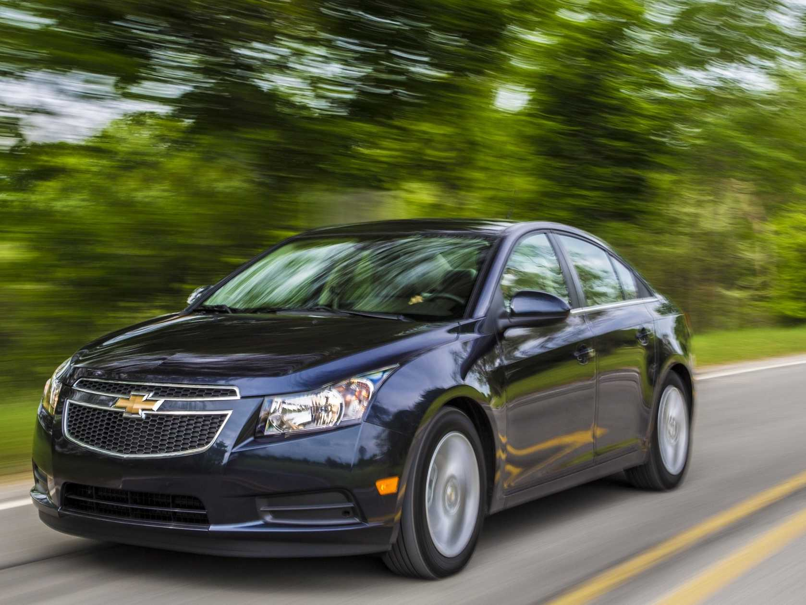
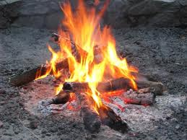
Transforming Energy
Energy can change from one form to another
Examples:
Electrical energy → light, thermal energy, sound
Chemical energy → kinetic energy to move a car, thermal energy of a fire
Light energy → into chemical bonds (plants do this – what’s it called?)

Slide 3
Conversions between kinetic and Potential Energy
Mechanical energy is the total amount of potential and kinetic energy in a system and can be expressed by this equation: Mechanical energy = potential energy + kinetic energy
It’s energy due to the position and motion of an object

Slide 4
The Law of Conservation of Energy
The law of conservation of energy states that energy cannot be created or destroyed.
Energy can change from one form to another, but the total amount of energy never changes.

