Slide 1
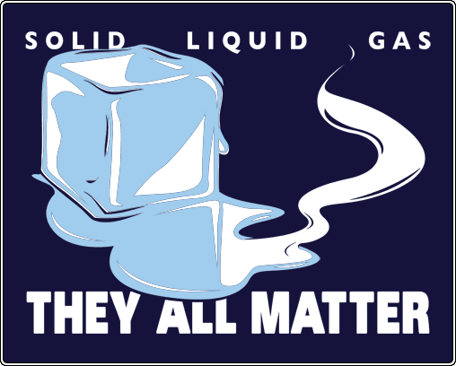
Classification of Matter

Slide 2
Composition of Matter
Chapter 15.1

Slide 3
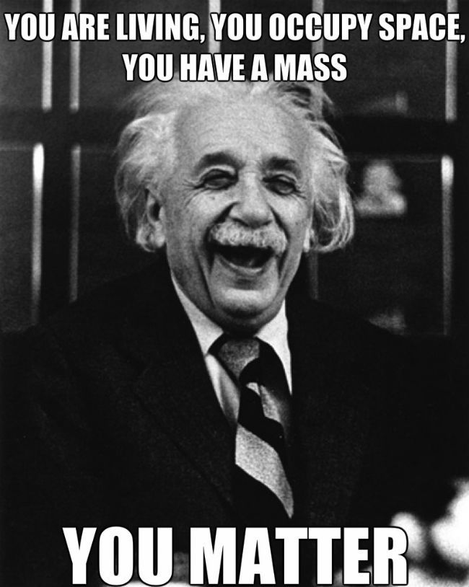
Matter
Matter: anything that has mass and takes up space

Slide 4
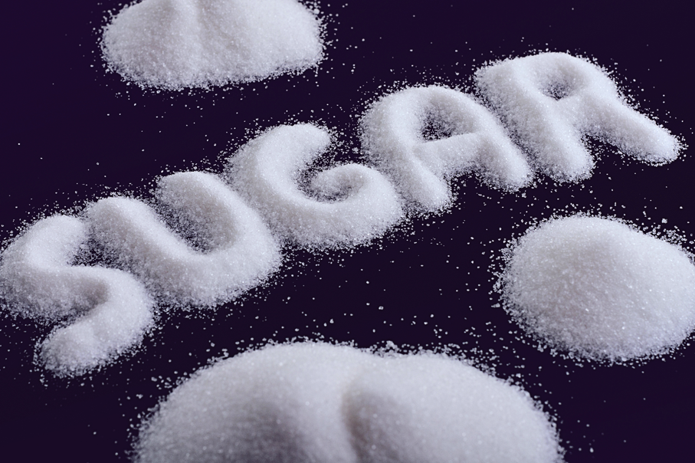
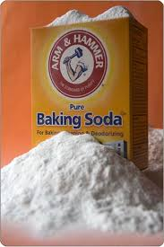
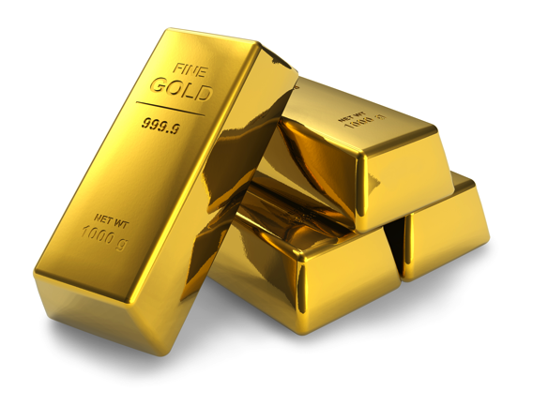
Pure Substances
A substance is a type of matter with a fixed composition
Can either be a an element or a compound
Ex. Helium, aluminum, water, salt

Slide 5
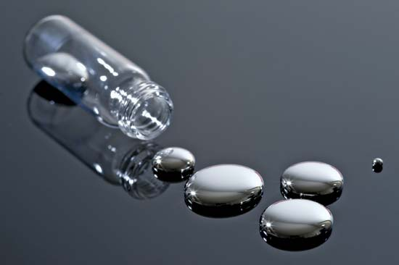
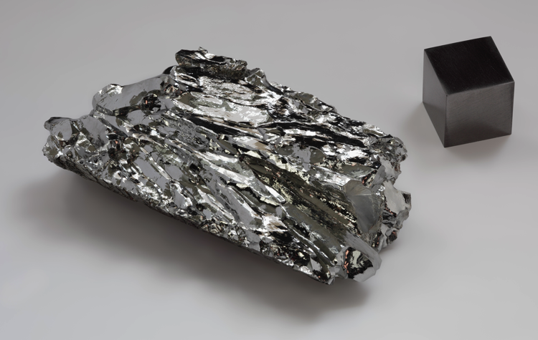
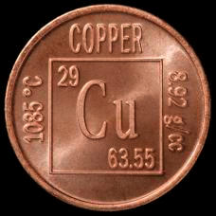
Pure Substances
All substances are built from atoms.
If all the atoms in a substance have the same identity, then that substance is an element
Example: copper, mercury, and all the other elements on the periodic table

Slide 6
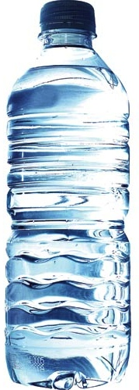
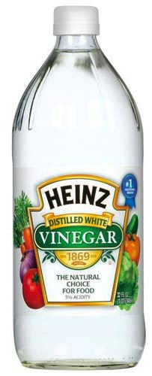
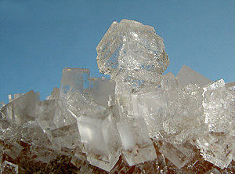
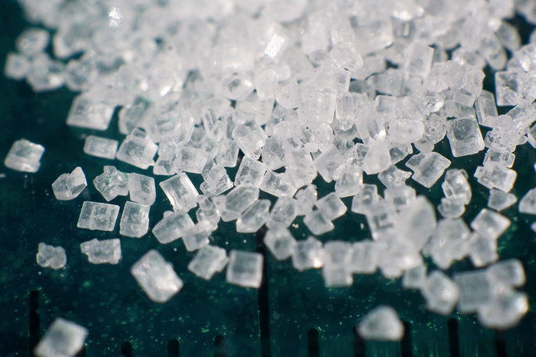
Pure substances
Compound is a substance in which the atoms of two or more elements are combined in a fixed proportion
Example: water, salt, sugar, baking soda
Salt
Sugar

Slide 7
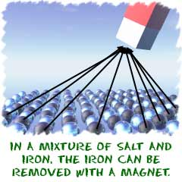
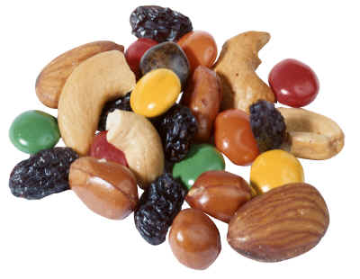
Mixtures
A mixture is a material made up of two or more substances that can be easily separated by physical means

Slide 8
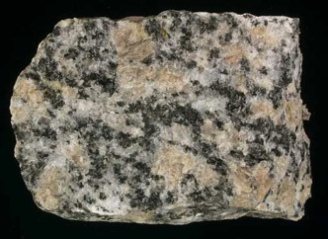
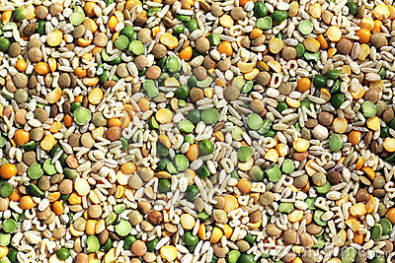
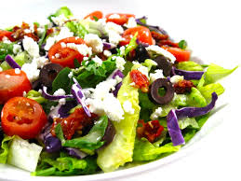
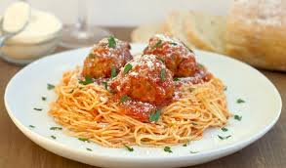
Mixtures
Heterogeneous mixture: the different components of the mixture can easily be distinguished
Ex: granite, concrete, dry soup mixes

Slide 9
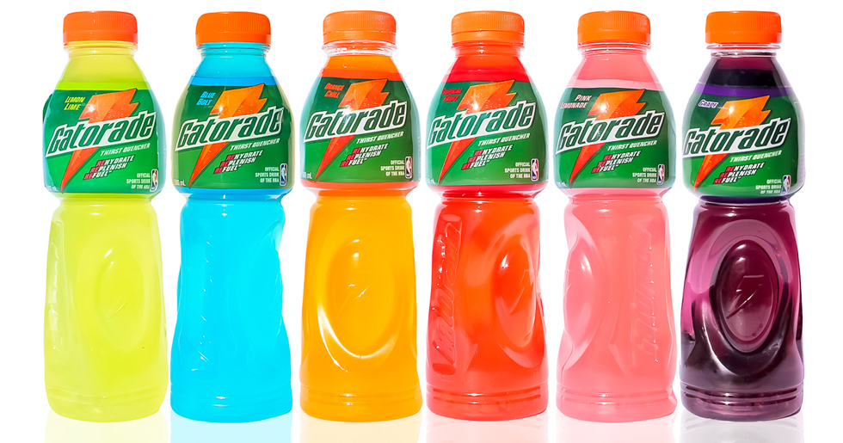
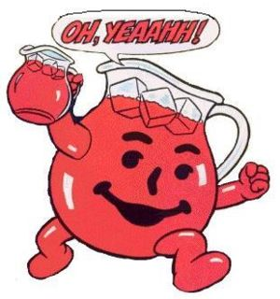
Mixtures
Homogeneous mixture: have a consistent composition and properties throughout. Consists of only one phase.
Solution: A homogeneous mixture of particles so small that they cannot be seen with a microscope and will never settle to the bottom of their container.

Slide 10
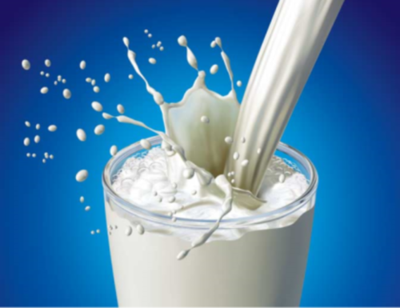
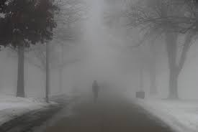
Colloids
Colloid: a type of mixture with particles that are larger than those in solutions but not heavy enough to settle out
Ex: paint, milk, fog, smoke

Slide 11
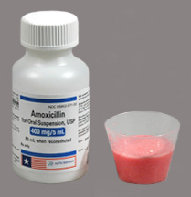
Suspensions
Suspension: a heterogeneous mixture containing a liquid in which visible particles settle
Ex: pond water

Slide 12
Identify the following substances as either: element, compound, homogeneous mixture, heterogeneous mixture, colloid or suspension
Sugar
Sweet tea
powerade
Carbon
smoke
A fresh glass of coca-cola
Compound
Homogeneous mixture
Homogeneous mixture
Element
Colloid
Heterogeneous mixture

Slide 13
Matter: Properties, Classification and Changes
Chapter 15.2

Slide 14
Properties of Matter
Physical Property - a quality or condition of matter that can be observed without changing the arrangement of atoms that make it
Examples:
color
size
shape
state of matter
Texture
These properties can usually be observed using our senses or are something measurable.
What are the physical properties of this penguin?

Slide 15
Chemical Properties – property that can only be observed when the arrangement of particles that make the matter are altered
These properties usually tell you how a substance will react in the presence of a second substance.
Examples:
Iron reacts with oxygen to form rust.
Metals react with acids to form hydrogen gas.

Slide 16
Identify the following as either a physical property or a chemical property.
Property | Physical | Chemical
a shirt is red
sodium is so soft it can be cut with a knife
potassium reacts vigorously with water
paper is flammable
water boils at 100 ºC
√
√
√
√
√

Slide 17
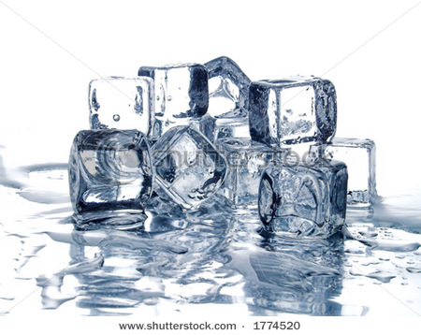
Changes in Matter
Physical Changes – changes in matter that does not alter the arrangement of atoms that make the matter
Changes in size, shape, and STATE OF MATTER.
Examples:
crumpling up a piece of paper
breaking a stick in half
melting ice
salt dissolving in water

Slide 18
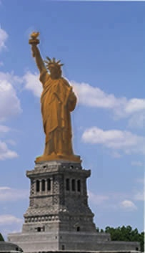
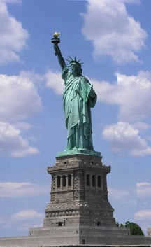
Chemical Changes - changes in matter that DO alter the arrangement of atoms that make up the matter
Because you can’t see the particles to determine if arrangement has changes, you can look for clues that tell you a chemical change has occurred.
Clues of a Chemical Change:
permanent color change
production of a solid (precipitate is formed)
production of a gas
change in energy (heat, light or sound)
odor change

Slide 19
Identify the following as either a physical change or a chemical change.
Change | Physical | Chemical
burning toast
breaking a glass
melting butter
leaves changing color
fireworks exploding
√
√
√
√
√

Slide 20
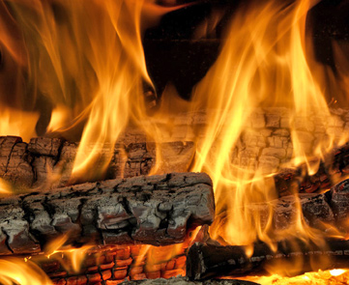
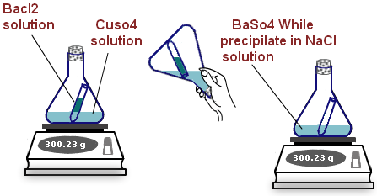
Law of conservation of mass
Matter is neither created nor destroyed during a chemical change
The mass of all substances that are present before a chemical change equals the mass of all the substances that remain after the change

