Slide 1
Motion
Chapter 2
Physical Science

Slide 2
Motion
A reference point is needed to determine the position of an object
Motion occurs when an object changes its position relative to a reference point.

Slide 3
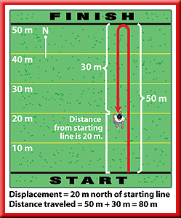
Distance vs. Displacement
Distance: How far you have moved
Displacement: is the distance and direction of an object’s change in position from the starting point.

Slide 4
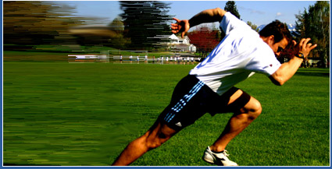
Speed
Speed is the distance an object travels per unit of time.
How fast an object is moving.

Slide 5
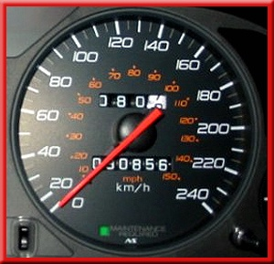
Average Speed vs. instantaneous speed
Average speed is the total distance traveled divided by the total time of travel.
Instantaneous speed: is the speed at a given point in time.

Slide 6
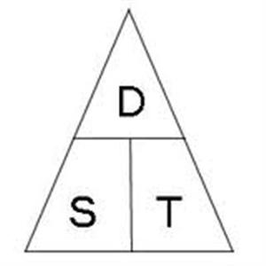
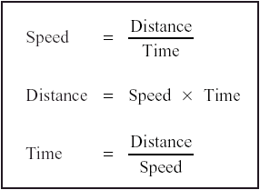
Calculating Speed
speed is the rate at which distance is traveled or the rate of change in position.

Slide 7
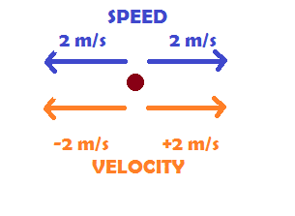
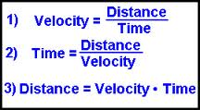
Velocity
Speed describes only how fast something is moving.
Velocity includes the speed of an object and the direction of its motion.

Slide 8
Practice Problem:
If the total distance traveled by a jogger was 15 km which took 3 hours to do, what was the jogger’s average speed?
If you drive your car at 60 mph for 3 hours straight without stopping, how far will you travel?

