Slide 1
Atoms, Ions, and Molecules
How are ions formed?
What are the similarities and differences of ionic and covalent bonds?

Slide 2
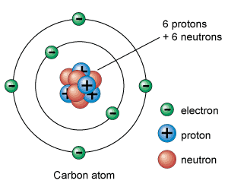
Living things consist of atoms of different elements
Atom – smallest basic unit of matter
Protons and neutrons located in nucleus
Electrons located in valence shells (energy levels) outside nucleus
Elements are particular types of atoms
Carbon, Hydrogen, Oxygen, and Nitrogen make up 96% of living things

Slide 3
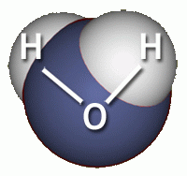
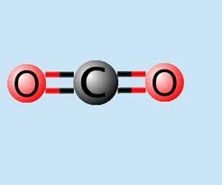
Living things consist of atoms of different elements
Compounds
Substance made when different elements are bonded together
Examples: CO₂, H₂O

Slide 4
Types of Bonds
Ionic Bond
Ions form when atoms lose or gain electrons
Atoms are more stable when their outer energy level is full
An atom with an energy level almost full will gain electrons
It will become negatively charged
An atom with an energy level almost empty will lose electrons
It will become positively charged
Negative and positive charges attract each other and form a bond

Slide 5
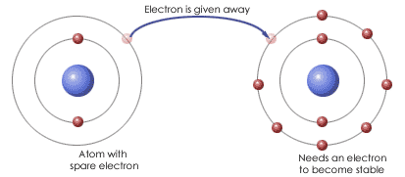
Ionic Bonding

Slide 6
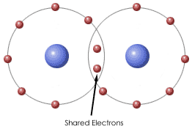
Types of Bonds
Covalent Bond
Atoms share electrons
Molecules from when two or more atoms are held together by a covalent bond

