Slide 1
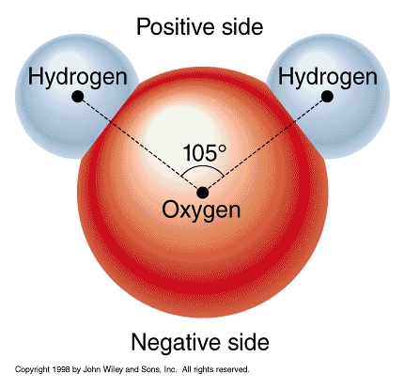
Characteristics of Water
1. A polar molecule meaning an unequal distribution of charges.
Draw a water molecule including its atoms and charges below.

Slide 2
Continued
2. Cohesion = high surface tension due to polarity. What is an example of cohesion?
3. Adhesion = capillary action due to polarity. What living things benefit the most from adhesion?

Slide 3
Continued
4. High Heat of Vaporization = A great deal of heat energy is needed to evaporate water due to polarity. How is this characteristic beneficial to ocean or lake life?
5. Resists temperature change. How is this characteristic beneficial to ocean or lake life?

Slide 4
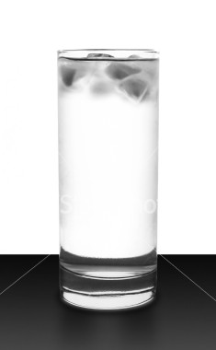
Continued
6. Expands when frozen so ice is less dense than liquid water. How is this evident in a glass of ice water?

Slide 5
pH
pH measures how acidic (an increase in H⁺ content) or basic ( increase in OH⁻ content) a substance is.
The pH scale is from 0 to 14.
Draw the scale below. Label “most acidic”, “most basic”, and neutral.
0 7 14
←------------------------------------------------------------------------→
Most Neutral Most
Acidic Basic

Slide 6
Buffers
Living organisms contain chemicals called buffers to help the organism maintain a constant pH.
Draw a buffered reaction below.
H⁺ H⁺ H⁺ OH⁻
H⁺ Strong Acid H⁺ + Weak Base OH⁻
H⁺ H⁺ H⁺ OH⁻
What will be the resulting product?

Slide 7
Continued
Weak Acid + H₂O
To lessen the acidity of the acid the weak base acted as a buffer by removing H⁺ . Water was created when the H⁺ attached to the OH⁻.

