Slide 1
Cell Theory
What are the developments that led to the cell theory?
What are the similarities and differences between prokaryotic and eukaryotic cells?

Slide 2
Discovery of Cells
Cells were not discovered until microscope was invented (1500’s)
Hooke first looked at pieces of cork (1665)
Coined the term “cell”
Leeuwenhoek first observed living cells
Schleiden (1838) concluded that all plants are made of cells
Schwann (1839) concluded that all animals are made of cells

Slide 3
Development of the Cell Theory
This accumulated research can be summarized into the cell theory:
All organisms are made of cells
All existing cells are produced by other living cells
The cell is the most basic unit of life

Slide 4
Prokaryotic Cells vs. Eukaryotic Cells
Prokaryotic Cells | Eukaryotic Cells
Lacks Nucleus | Has Nucleus
Lacks Organelles | Has Organelles
Very small in size | Larger in size
Examples: Bacteria | Examples: Protists, Fungi, Plants, Animals

Slide 5
Prokaryotic Cells vs. Eukaryotic Cells
Similarities of Both Types of Cells:
Cell Walls
Cell (Plasma) Membrane
Ribosomes
Nucleic Acid

Slide 6
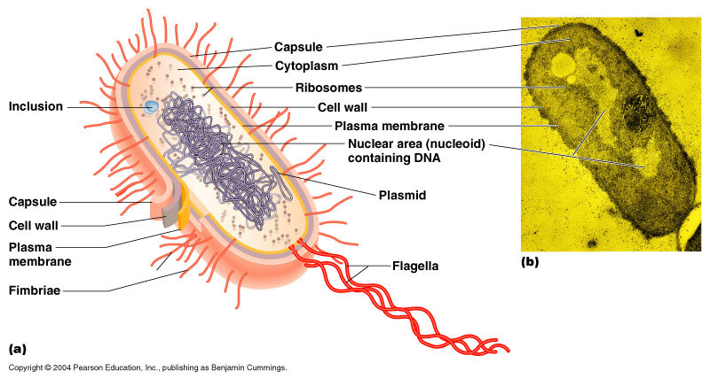
Prokaryotic Cell

Slide 7
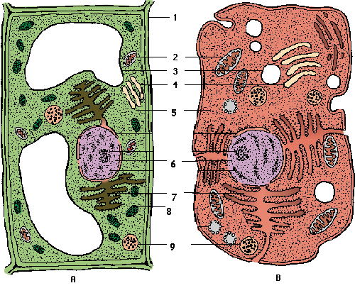
Eukaryotic Cell

