Slide 1
Bryophytes (Mosses and Relatives)
What types of plants are seedless and nonvascular?
How do mosses reproduce?

Slide 2
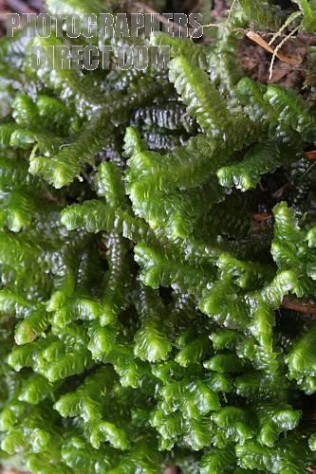
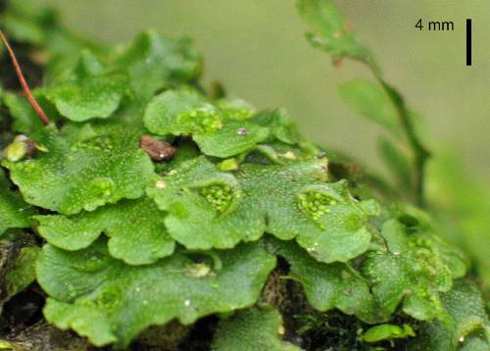
Types of Seedless Nonvascular Plants
Liverworts
Live in damp environments
Two forms: thallose or leafy

Slide 3
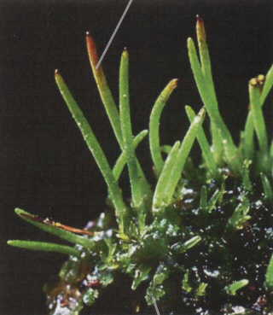
Types of Seedless Nonvascular Plants
Hornworts
Live in tropical forests and along streams
Grow horn-like structures for reproduction

Slide 4
Types of Seedless Nonvascular Plants
Mosses
Prefer moist conditions, but can enter a stage of dormancy when water is not available
Only 1 cell thick
Anchor themselves to surfaces with rhizoids (root-like structures)
Humans use sphagnum moss as a fuel source

Slide 5
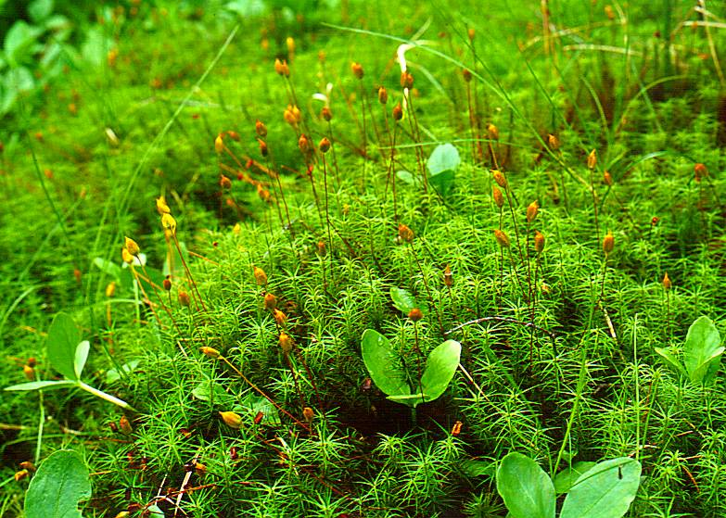
Mosses

Slide 6
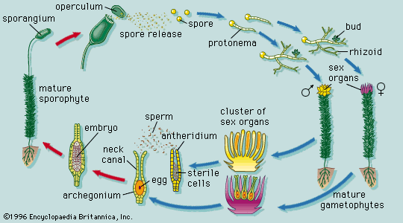
Moss Reproduction

Slide 7
Moss Reproduction
Plants undergo alternation of generations when they reproduce
Alternate between gametophyte stage and sporophyte stage
Gametophyte (haploid structures) – produces gametes
Sporophyte (diploid structures)– produces spores
Gametophyte stage of moss (green portion of moss)
Antheridium – produces sperm
Archegonium – produces eggs
Sporophyte stage of moss (brown stalk)
Produces haploid spores

