Slide 1
Biogeochemical Cycles
How do nutrients cycle through our environment

Slide 2
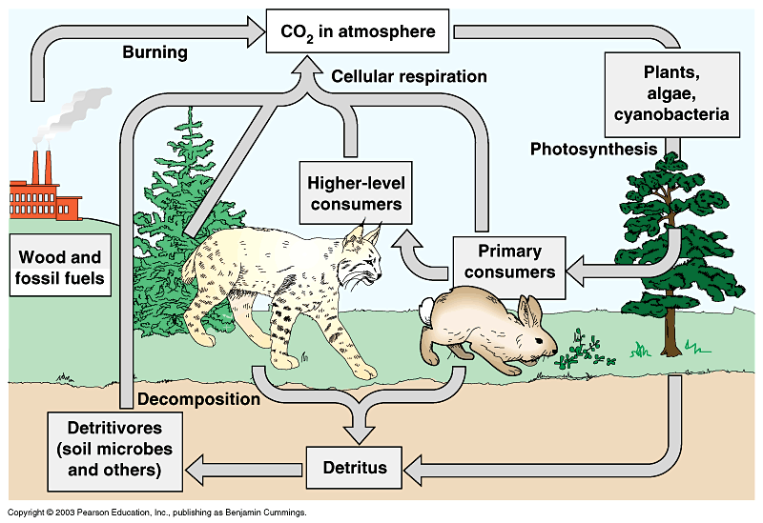
CARBON CYCLE

Slide 3
CARBON CYCLE
CO₂ exists naturally in atmosphere as a result of cellular respiration
Photosynthesis removes CO₂
Converts it into organic molecules for consumers
When consumers die, decomposers add carbon to soil
Problems:
Excess CO₂ in atmosphere from burning fossil fuels
Contributes to global warming

Slide 4
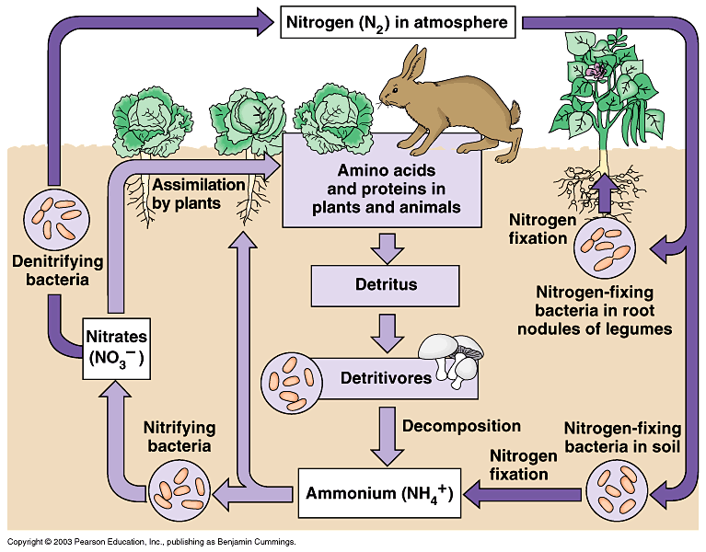
NITROGEN CYCLE

Slide 5
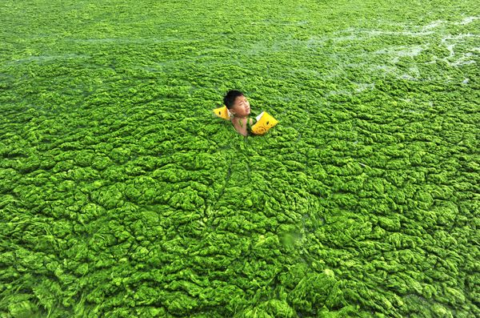
NITROGEN CYCLE
Nitrogen exists in atmosphere as N2
N2 is absorbed into soil
Bacteria and fungi convert N2 into ammonium (NH₄⁺) or nitrates (NO₃⁻) for plants to use
Problems:
Fertilizer contains manufactured nitrogen that runs off into water
This creates algal blooms

Slide 6
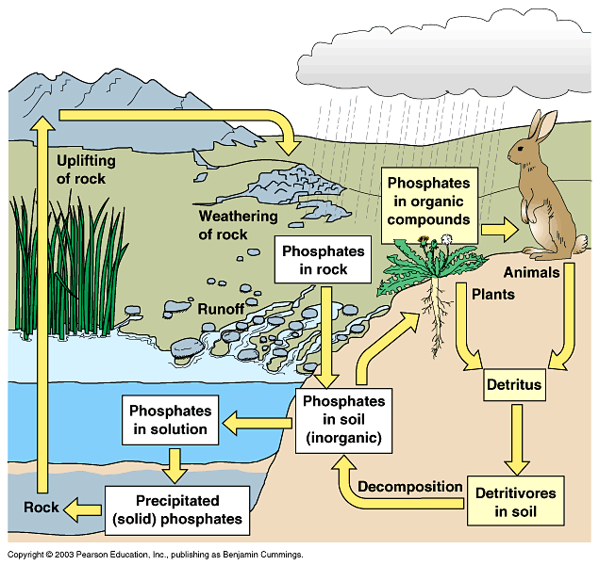
PHOSPHOROUS CYCLE

Slide 7
PHOSPHOROUS CYCLE
Phosphorous exists naturally in rocks
As rocks erode, phosphorous enters soil and groundwater
When new rocks are formed, phosphorous returns to rocks
Problems:
Phosphorous in detergents enters streams and lakes
Creates algal blooms

Slide 8
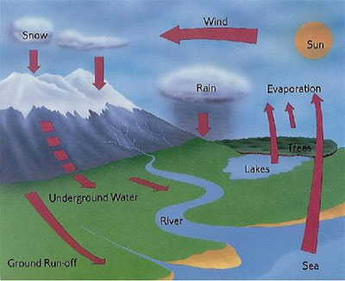
HYDROLOGIC CYCLE

Slide 9
HYDROLOGIC CYCLE
Precipitation falls to ground and enters lakes, streams, groundwater, and oceans
Evaporation from these bodies of water returns water to atmosphere
Problems:
Pollution of water sources limits groundwater supplies

