Slide 1
Behavior of Gases
Chpt 16.3

Slide 2
Setting Up Your Foldable:
P T V
2) You get one half of the paper, your neighbor gets the other
3) Make the front look like this
1) Fold paper hotdog style and cut in half.
4) Flip your paper over
HORIZONTALLY and make the back look like this.
NOTE: behind Charles’s Law should be the “P”
Gay-Lussac’s Law
Boyle’s Law
Charles’s Law

Slide 3
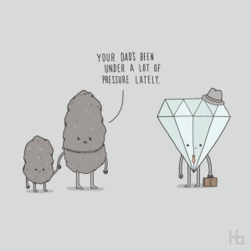
Pressure
Pressure is the amount of force exerted per unit of area
Pressure is measured in a unit called a pascal.

Slide 4
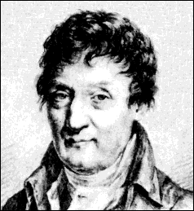
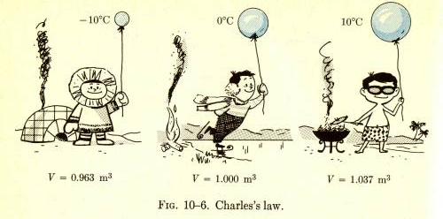
Charles’s Law
If pressure stays constant, then:
If the volume of gas increases, the temperature will increase
If the volume of gas decreases, the temperature will decrease

Slide 5
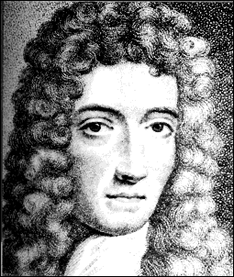
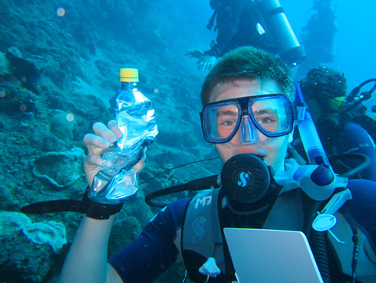
Boyle’s Law
If temperature remains constant, then
Decrease the volume, the pressure of the gas will increase
Increase the volume, the pressure of the gas will decrease

Slide 6
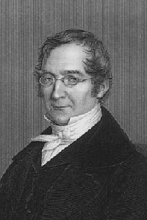
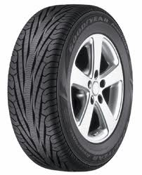
Gay-Lussac's Law
If the volume remains constant, then:
If the temperature of a container is increased, the pressure increases.
If the temperature of a container is decreased, the pressure decreases.

Slide 7
Check for understanding
If the volume of a gas remains constant, how does increasing the temperature of the gas effect the pressure of the gas?
Which law is this?

