Slide 1
Alternative Inheritance Patterns
What inheritance patterns exist aside from simple dominance?

Slide 2
Incomplete Dominance
Neither allele is dominant
The heterozygous condition appears to be blended
Red flowers (RR) x White flowers (WW)
All offspring are pink (RW)
 | R | R
W | RW | RW
W | RW | RW

Slide 3
Incomplete Dominance
Heterozygous condition is not blended because homozygous condition reappears
RW x RW
1 Red: 2 Pink: 1 White
 | R | W
R | RR | RW
W | RW | WW

Slide 4
Codominance
Both alleles act as dominant alleles
Heterozygous condition has both alleles present
White Cattle (WW) x Red Cattle (RR)
All roan cattle – cattle that has both red and white hairs present
 | W | W
R | RW | RW
R | RW | RW

Slide 5
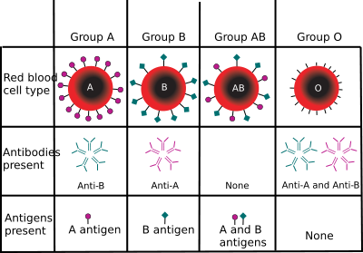
Multiple Alleles
One gene that has more than two alleles
Blood Types are an example
A, B, AB, O
Presence of an antigen (I), absence of antigen (i)
Different types of antigens (A and B)

Slide 6
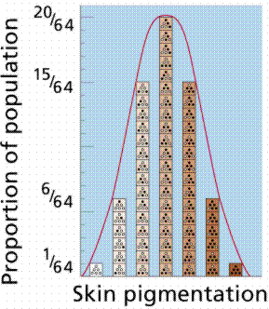
Polygenic Traits
One trait is controlled by multiple genes
Examples are hair color, eye color, skin color

Slide 7
Sample Problems
A yellow guinea pig is crossed with a white guinea pig. All of the offspring are cream-colored. The cream-colored animals are crossed. Sixteen yellow, 33 cream, and 15 white animals are born. Explain these results. Explain how a white breed could be developed by starting with two cream-colored parents. Draw a Punnett square to illustrate your conclusion.

Slide 8
Sample Problems
In four o’clocks, red flower color (R) is only partially dominant over white (r), the heterozygous being pink. How would you produce seed all of which would produce pink-flowered plants?

